Slide 1
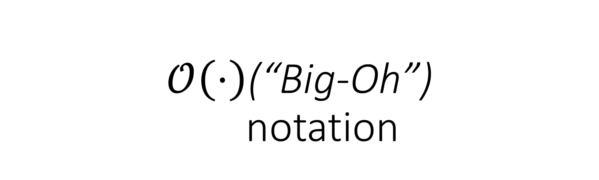
$$𝒪\left(⋅\right)\text{(“}\text{Big}\text{−}\text{Oh}\text{”)}$$ notation
CMSC 250

Slide 2
Logistics / Reminders
All grades for graded assignments on ELMS.
Stats in yesterday night’s announcement.
HW 06 posted yesterday!
Quite long; please begin asap!
Today: Big-Oh notation.
Thursday: intro to proofs

Slide 3
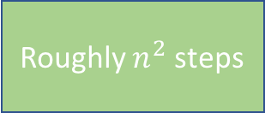

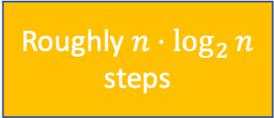
A loop example
for(i = 1 to n)
for(j=1 to i)
print “Hello”;
How fast will this run (as a function of n?)
Roughly $n$ steps
Roughly $n^{2}$ steps
Roughly $n⋅\log_{2}{n}$ steps
Something Else

Slide 4
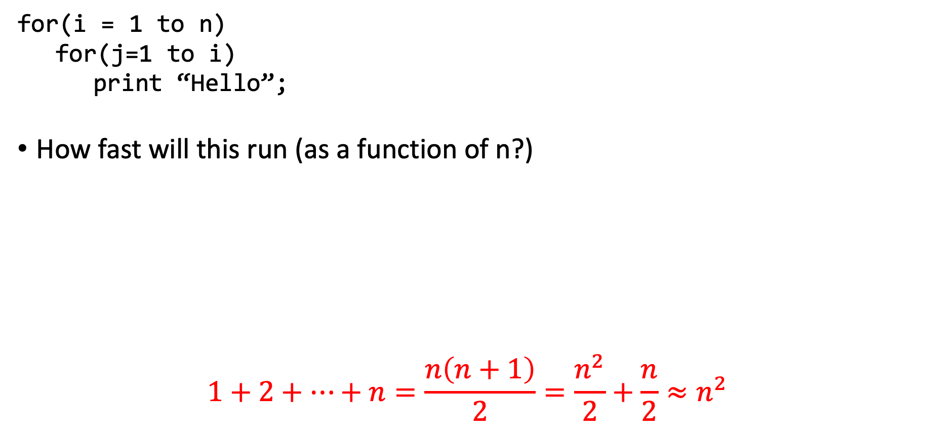
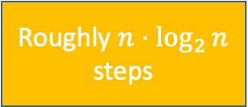
A loop example
for(i = 1 to n)
for(j=1 to i)
print “Hello”;
How fast will this run (as a function of n?)
$$1+2+…+n=\frac{n\left(n+1\right)}{2}=\frac{n^{2}}{2}+\frac{n}{2}≈n^{2}$$
Roughly $n$ steps
Roughly $n^{2}$ steps
Roughly $n⋅\log_{2}{n}$ steps
Something Else

Slide 5
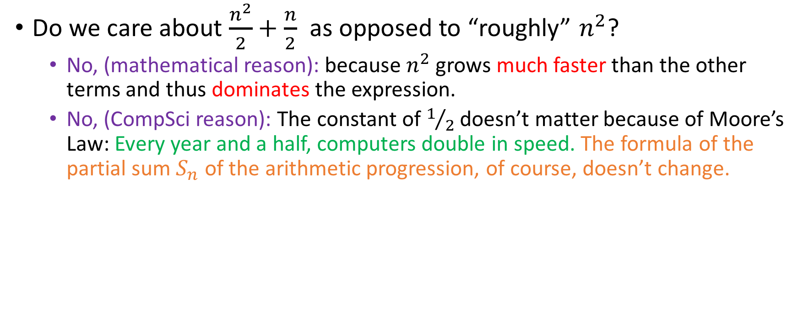
What do we care about?
Do we care about $\frac{n^{2}}{2}+\frac{n}{2}$ as opposed to “roughly” $n^{2}$?
No, (mathematical reason): because $n^{2}$ grows much faster than the other terms and thus dominates the expression.
No, (CompSci reason): The constant of $1/2$ doesn’t matter because of Moore’s Law: Every year and a half, computers double in speed. The formula of the partial sum $S_{n}$ of the arithmetic progression, of course, doesn’t change.

Slide 6
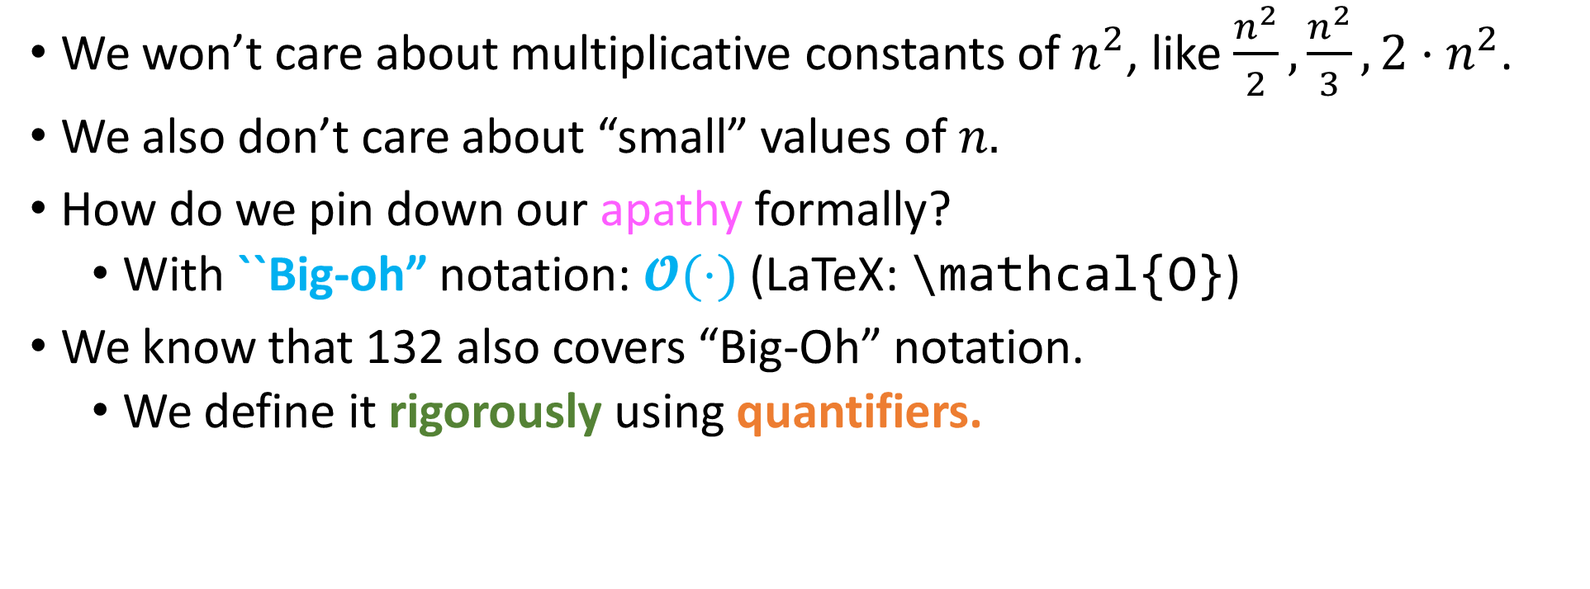

How to define “roughly” $n^{2}?$
We won’t care about multiplicative constants of $n^{2}$, like $\frac{n^{2}}{2},\frac{n^{2}}{3}, 2⋅n^{2}$.
We also don’t care about “small” values of $n.$
How do we pin down our apathy formally?
With ``Big-oh” notation: $𝓞(⋅)$ (LaTeX: \mathcal{O})
We know that 132 also covers “Big-Oh” notation.
We define it rigorously using quantifiers.

Slide 7
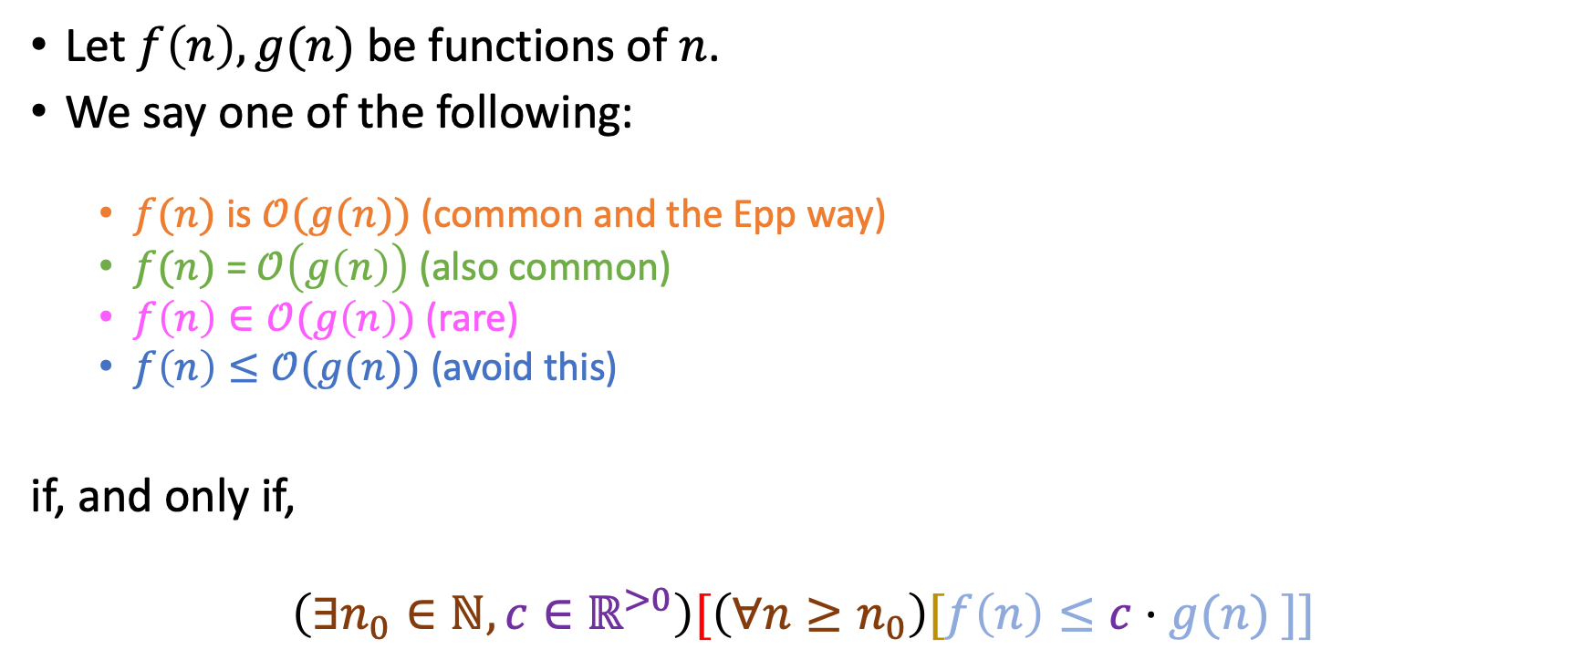
Formal definition of “Big-Oh”
Let $f\left(n\right), g(n)$ be functions of $n$.
We say one of the following:
$f(n)$ is $𝒪(g(n))$ (common and the Epp way)
$f(n)$ = $𝒪\left(g\left(n\right)\right)$ (also common)
$f\left(n\right)∈𝒪(g\left(n\right))$ (rare)
$f\left(n\right)≤𝒪(g(n))$ (avoid this)
if, and only if,
$$\left(∃n_{0}∈ℕ, c∈ℝ^{>0}\right)[\left(∀n≥n_{0}\right)[f\left(n\right)≤c⋅g(n) ]]$$

Slide 8
Formal definition of “Big-Oh”
Let $f\left(n\right), g(n)$ be functions of $n$.
We say one of the following:
$f(n)$ is $𝒪(g(n))$ (common and the Epp way)
$f(n)$ = $𝒪\left(g\left(n\right)\right)$ (also common)
$f\left(n\right)∈𝒪(g\left(n\right))$ (rare)
$f\left(n\right)≤𝒪(g(n))$ (avoid this)
if, and only if,
$$\left(∃n_{0}∈ℕ, c∈ℝ^{>0}\right)[\left(∀n≥n_{0}\right)[f\left(n\right)≤c⋅g(n) ]]$$
That’s why we suggest that you avoid this notation: easy to confuse the inequalities.

Slide 9
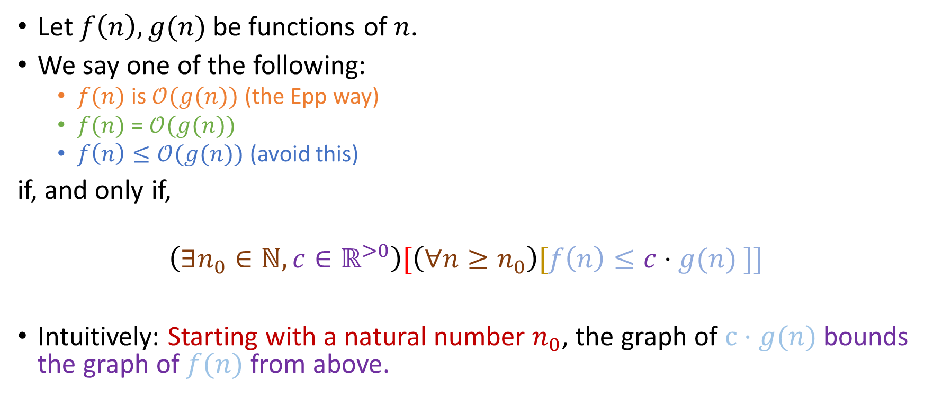
Formal definition of “Big-Oh”
Let $f\left(n\right), g(n)$ be functions of $n$.
We say one of the following:
$f(n)$ is $𝒪(g(n))$ (the Epp way)
$f(n)$ = $𝒪(g(n))$
$f\left(n\right)≤𝒪(g(n))$ (avoid this)
if, and only if,
$$\left(∃n_{0}∈ℕ, c∈ℝ^{>0}\right)[\left(∀n≥n_{0}\right)[f\left(n\right)≤c⋅g(n) ]]$$
Intuitively: Starting with a natural number $n_{0}$, the graph of $c⋅g(n)$ bounds the graph of $f(n)$ from above.
That’s why we suggest that you avoid this: easy to confuse the inequalities.

Slide 10
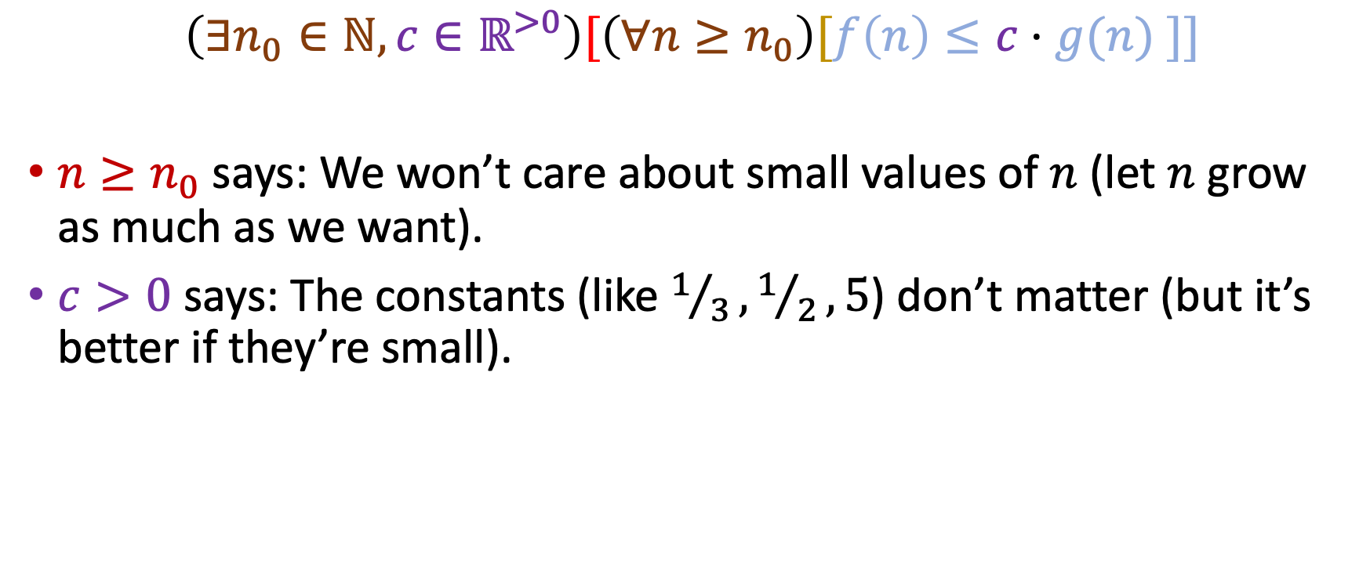

Choice of $n_{0}, c$
$$\left(∃n_{0}∈ℕ, c∈ℝ^{>0}\right)[\left(∀n≥n_{0}\right)[f\left(n\right)≤c⋅g(n) ]]$$
$n≥n_{0}$ says: We won’t care about small values of $n$ (let $n$ grow as much as we want).
$c>0$ says: The constants (like $1/3,1/2, 5\text{)}$ don’t matter (but it’s better if they’re small).

Slide 11
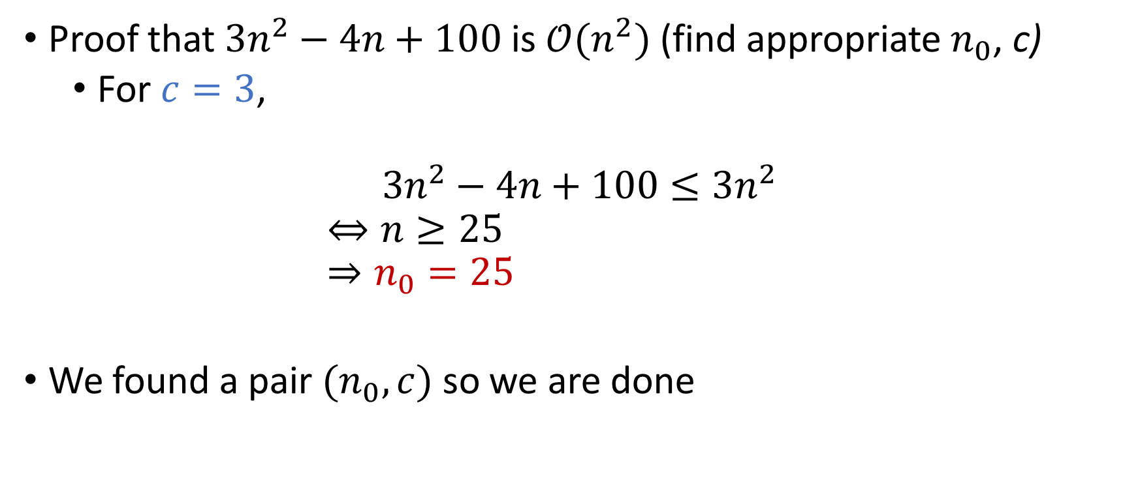

Example of finding $n_{0}$, c
Proof that $3n^{2}−4n+100$ is $𝒪(n^{2})$ (find appropriate $n_{0}$, c)
For $c=3$,
$$3n^{2}−4n+100≤3n^{2} \\ ⇔n≥25 \\ ⇒n_{0}=25$$
We found a pair $(n_{0},c)$ so we are done

Slide 12
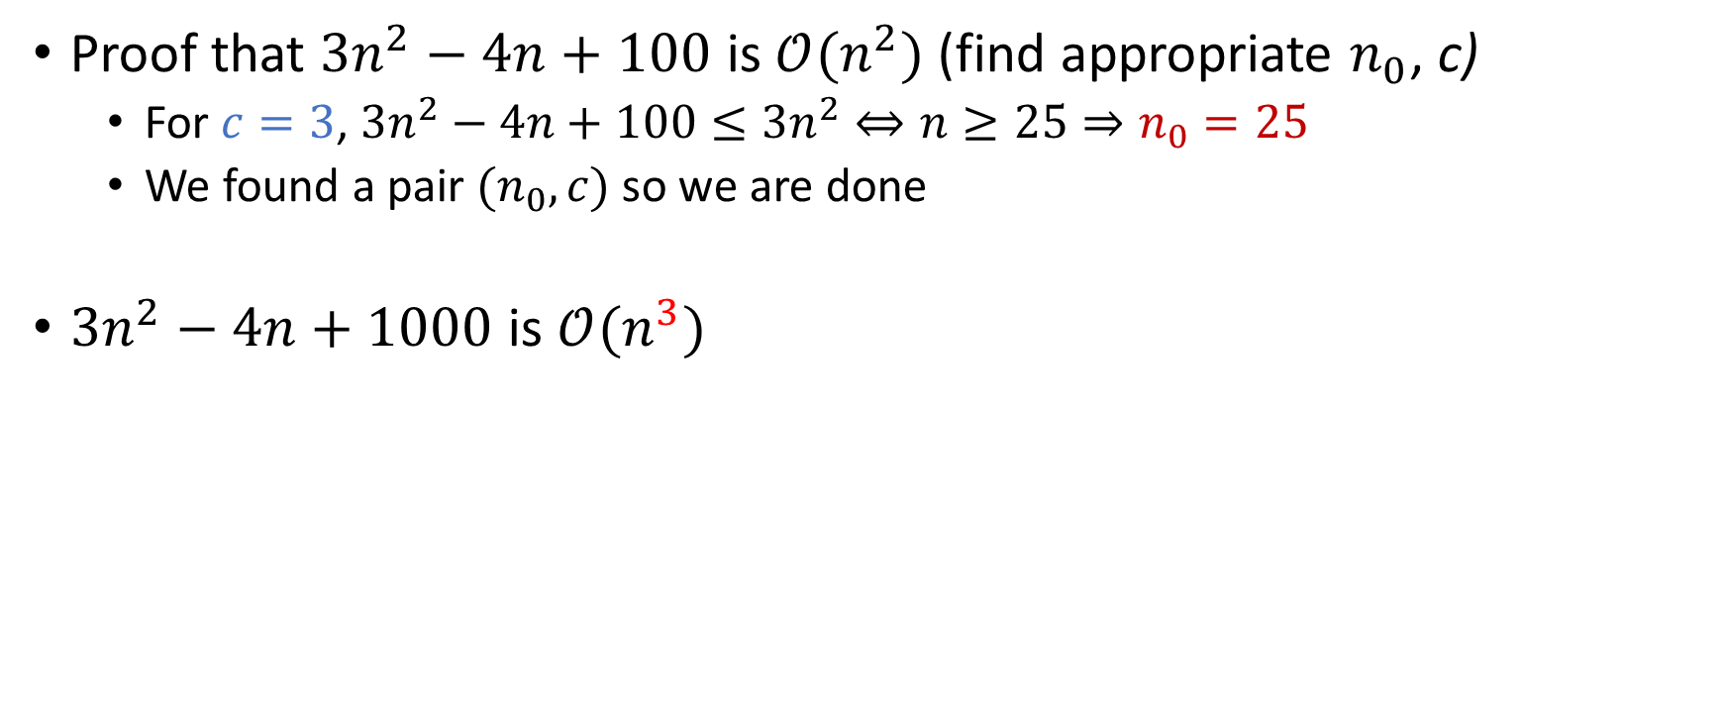
Example of finding $n_{0}$, c
Proof that $3n^{2}−4n+100$ is $𝒪(n^{2})$ (find appropriate $n_{0}$, c)
For $c=3$, $3n^{2}−4n+100≤3n^{2}⇔n≥25⇒n_{0}=25$
We found a pair $(n_{0},c)$ so we are done
$3n^{2}−4n+1000$ is $𝒪(n^{3})$
True
False
Something Else

Slide 13


Example of finding $n_{0}$, c
Proof that $3n^{2}−4n+1000$ is $𝒪(n^{2})$ (find appropriate $n_{0}$, c)
For $c=3$, $3n^{2}−4n+100≤3n^{2}⇔n≥25⇒n_{0}=25$
We found a pair $(n_{0},c)$ so we are done
$3n^{2}−4n+1000$ is $𝒪(n^{3})$
True
False
Something Else
For $c=3,$ $3n^{2}−4n+100≤3⋅n^{3}⇔3n^{3}−3n^{2}+4n −100≥0$
Valid for $n≥4$

Slide 14
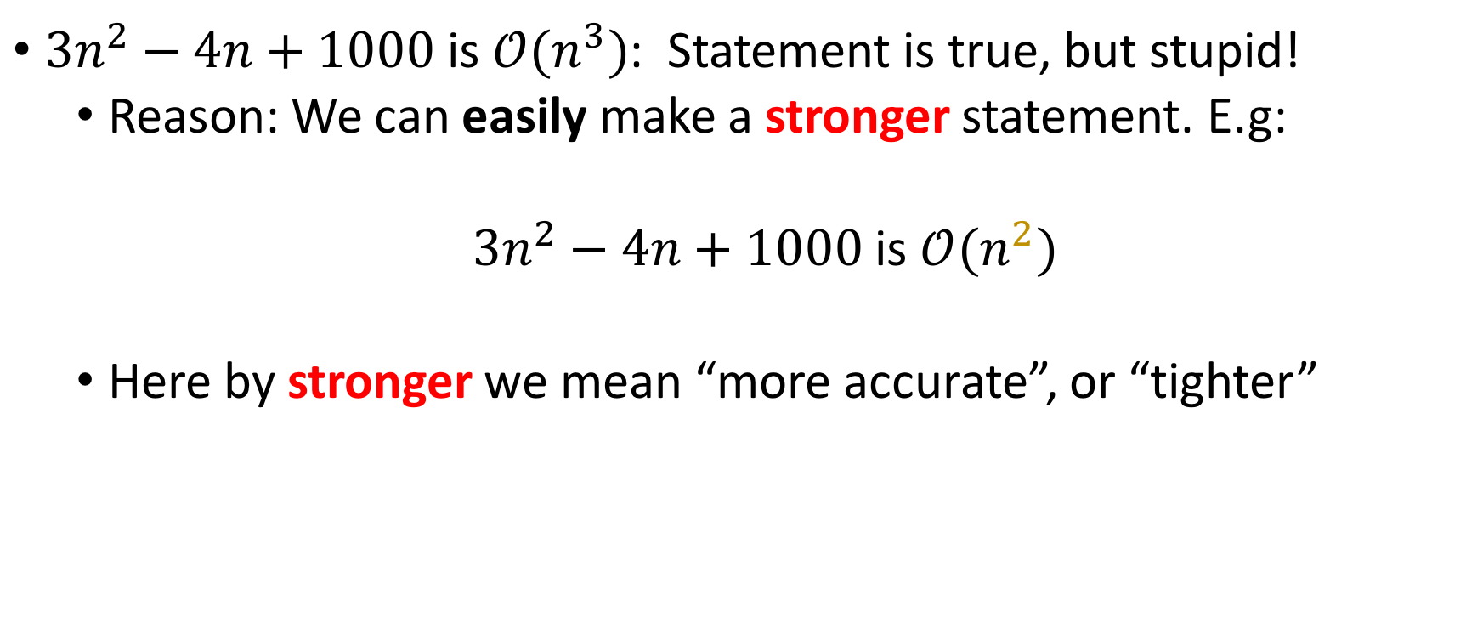
True, but stupid
$3n^{2}−4n+1000$ is $𝒪(n^{3})$: Statement is true, but stupid!
Reason: We can easily make a stronger statement. E.g:
$3n^{2}−4n+1000$ is $𝒪(n^{2})$
Here by stronger we mean “more accurate”, or “tighter”

Slide 15
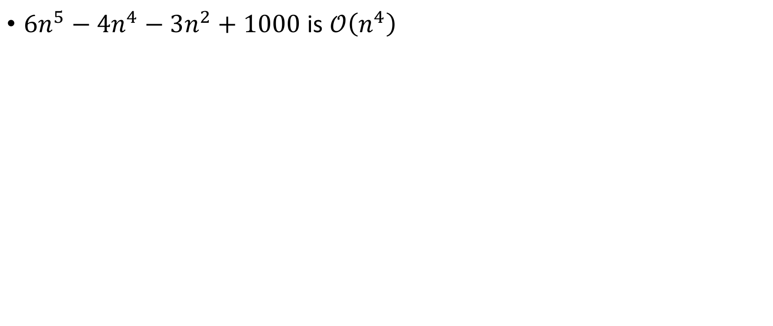
Polynomials
True and interesting
True but Stupid
False
$6n^{5}−4n^{4}−3n^{2}+1000$ is $𝒪\left(n^{4}\right)$

Slide 16
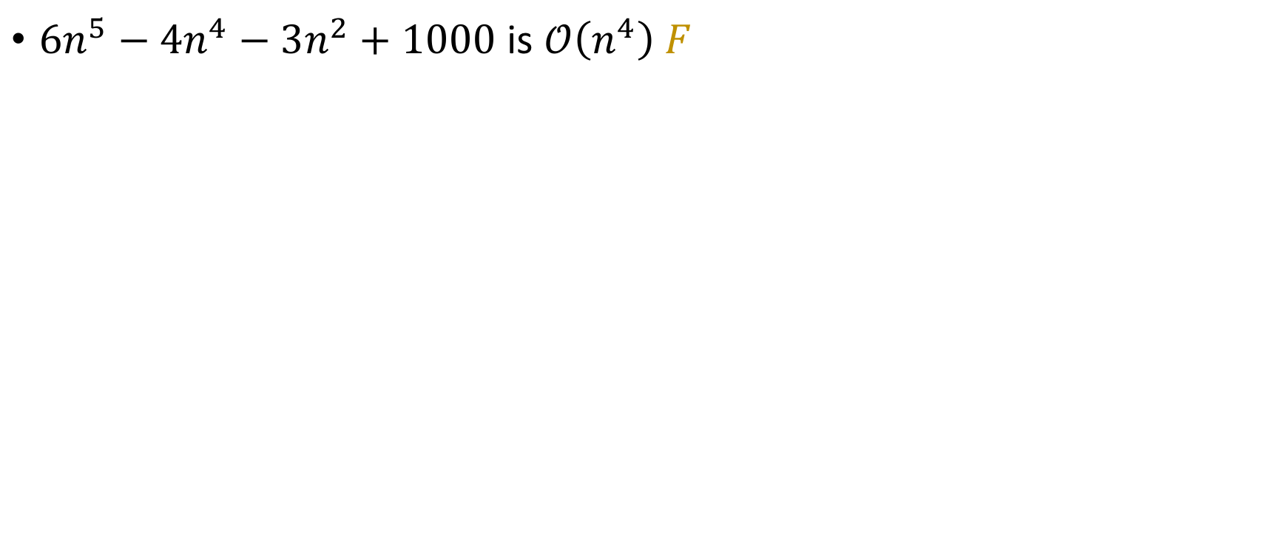
Polynomials
True and interesting
True but Stupid
False
$6n^{5}−4n^{4}−3n^{2}+1000$ is $𝒪\left(n^{4}\right) F$

Slide 17

Polynomials
True and interesting
True but Stupid
False
$6n^{5}−4n^{4}−3n^{2}+1000$ is $𝒪\left(n^{4}\right) F$
$6n^{5}−4n^{4}−3n^{2}+1000$ is $𝒪(n^{4.9})$

Slide 18
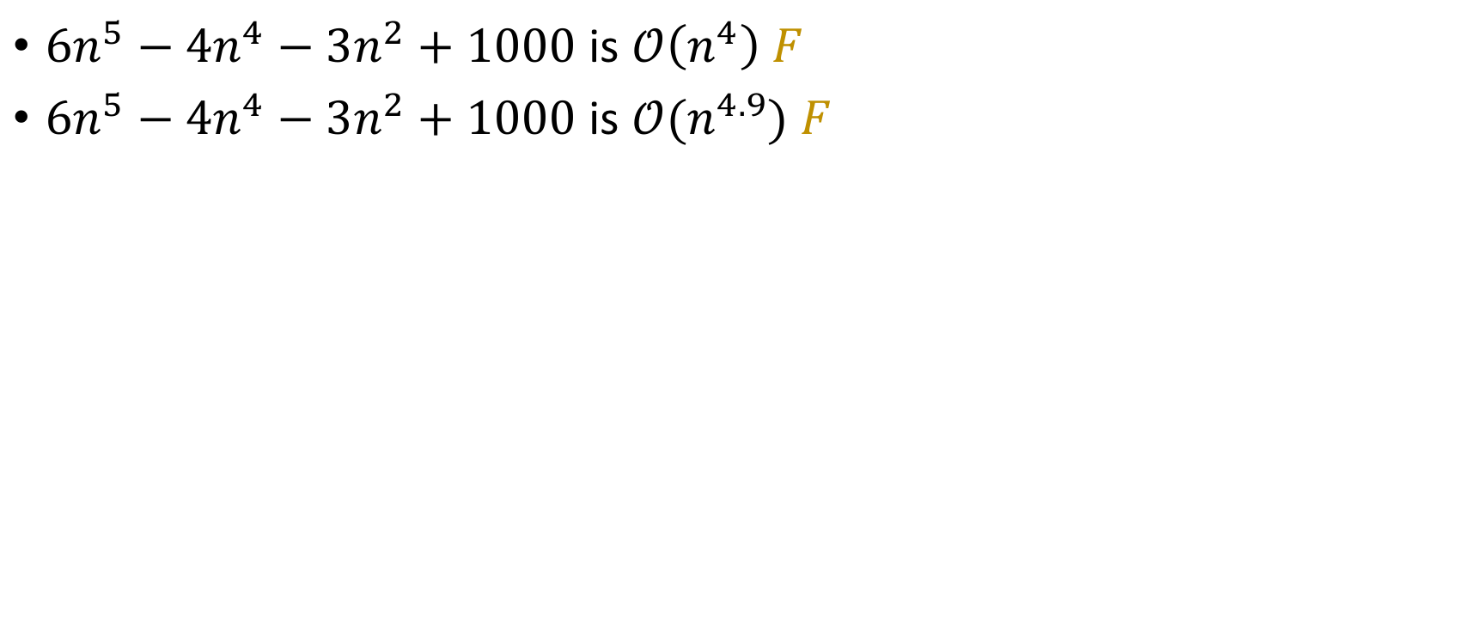
Polynomials
True and interesting
True but Stupid
False
$6n^{5}−4n^{4}−3n^{2}+1000$ is $𝒪\left(n^{4}\right) F$
$6n^{5}−4n^{4}−3n^{2}+1000$ is $𝒪(n^{4.9})$ $F$

Slide 19
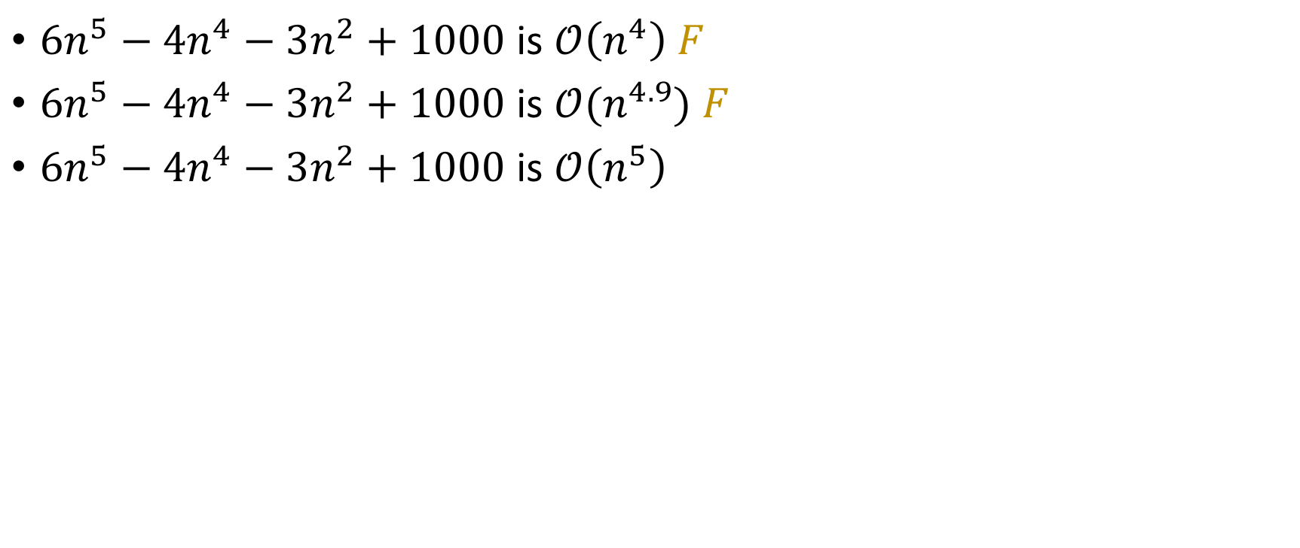
Polynomials
True and interesting
True but Stupid
False
$6n^{5}−4n^{4}−3n^{2}+1000$ is $𝒪\left(n^{4}\right) F$
$6n^{5}−4n^{4}−3n^{2}+1000$ is $𝒪(n^{4.9})$ $F$
$6n^{5}−4n^{4}−3n^{2}+1000$ is $𝒪\left(n^{5}\right)$

Slide 20
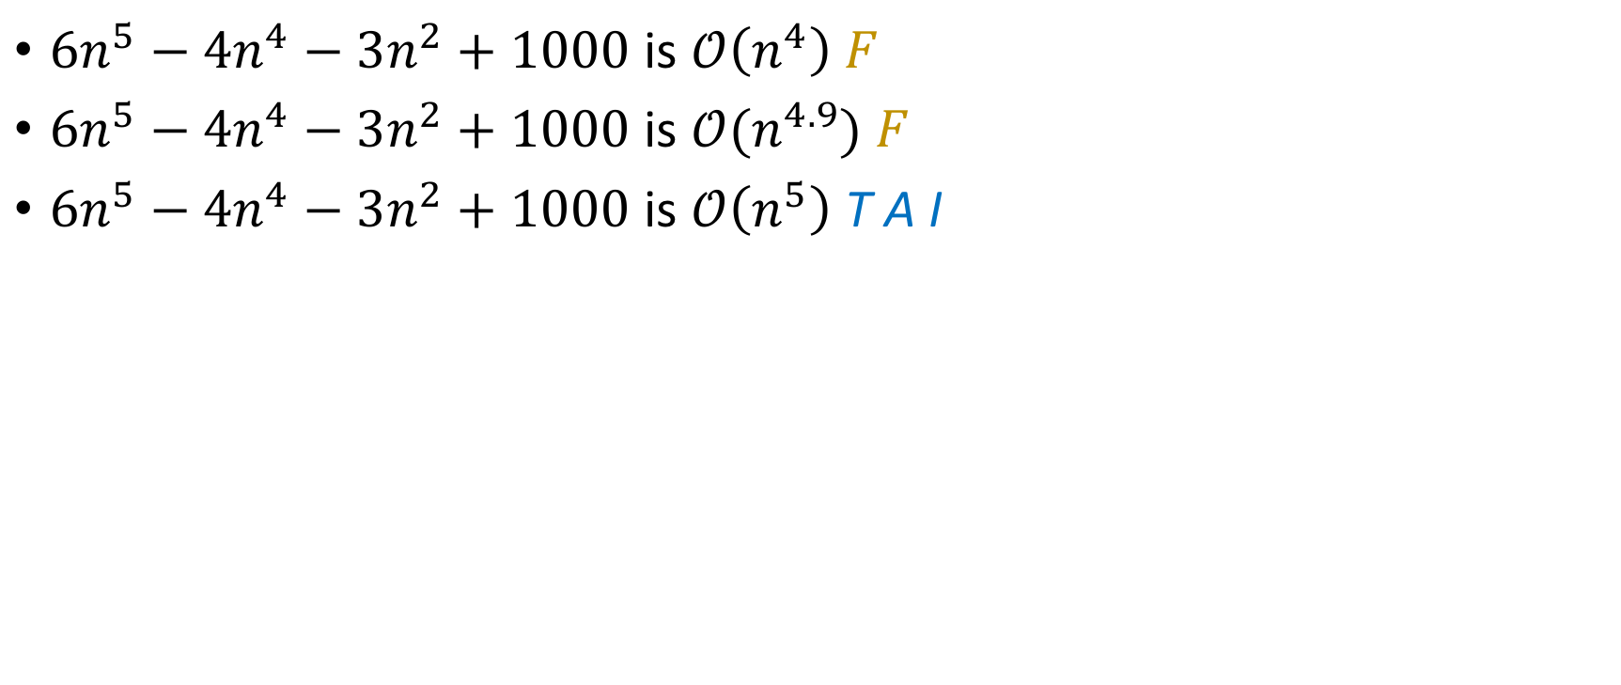
Polynomials
True and interesting
True but Stupid
False
$6n^{5}−4n^{4}−3n^{2}+1000$ is $𝒪\left(n^{4}\right) F$
$6n^{5}−4n^{4}−3n^{2}+1000$ is $𝒪(n^{4.9})$ $F$
$6n^{5}−4n^{4}−3n^{2}+1000$ is $𝒪\left(n^{5}\right)$ T A I

Slide 21

Polynomials
True and interesting
True but Stupid
False
$6n^{5}−4n^{4}−3n^{2}+1000$ is $𝒪\left(n^{4}\right) F$
$6n^{5}−4n^{4}−3n^{2}+1000$ is $𝒪(n^{4.9})$ $F$
$6n^{5}−4n^{4}−3n^{2}+1000$ is $𝒪\left(n^{5}\right)$ T A I
$6n^{5}−4n^{4}−3n^{2}+1000$ is $𝒪(n^{5.1})$

Slide 22
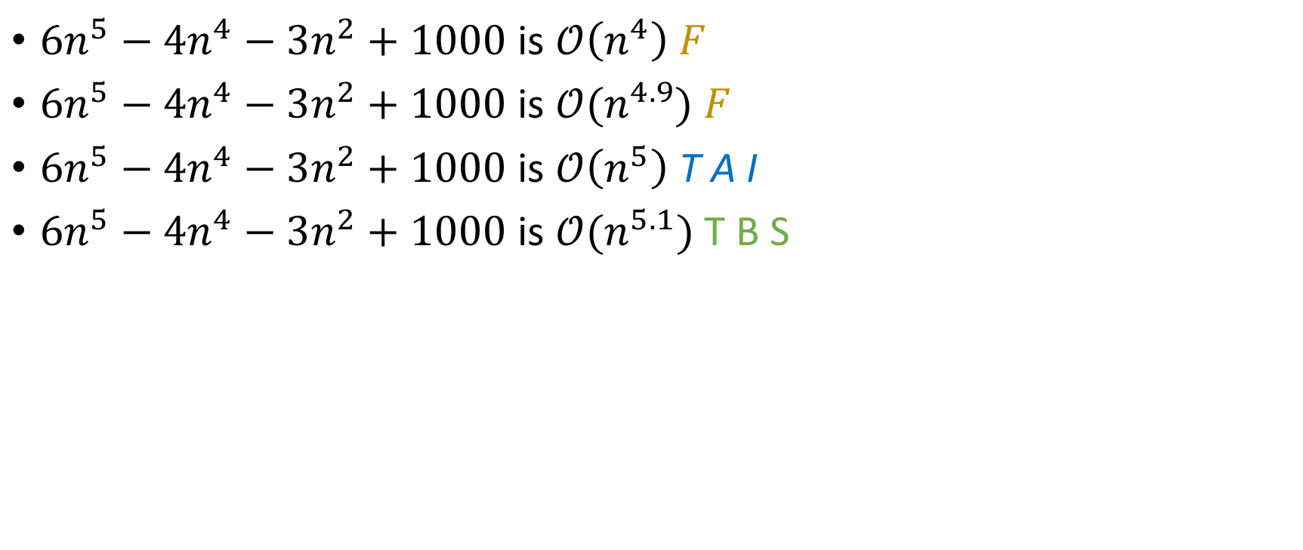
Polynomials
True and interesting
True but Stupid
False
$6n^{5}−4n^{4}−3n^{2}+1000$ is $𝒪\left(n^{4}\right) F$
$6n^{5}−4n^{4}−3n^{2}+1000$ is $𝒪(n^{4.9})$ $F$
$6n^{5}−4n^{4}−3n^{2}+1000$ is $𝒪\left(n^{5}\right)$ T A I
$6n^{5}−4n^{4}−3n^{2}+1000$ is $𝒪(n^{5.1})$ T B S

Slide 23
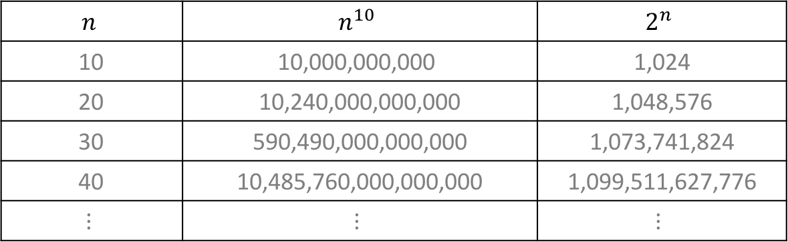
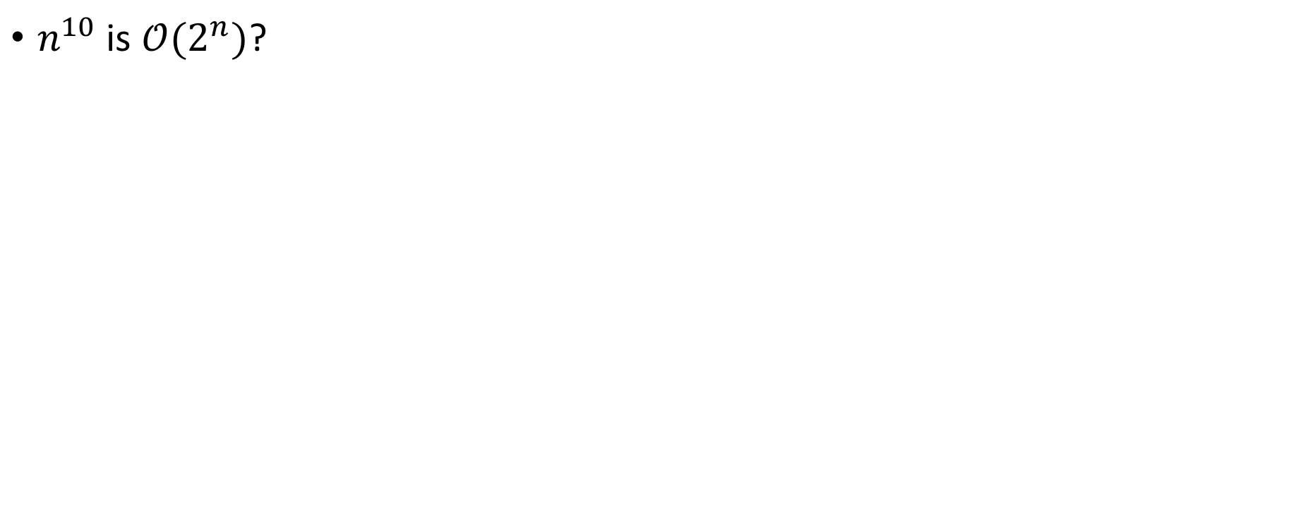
Polynomial vs Exponential
True and interesting
$$n$$ | $$n^{10}$$ | $$2^{n}$$
10 | $$\text{10}\text{,}\text{000}\text{,}\text{000}\text{,}\text{000}$$ | 1,024
20 | 10,240,000,000,000 | 1,048,576
30 | 590,490,000,000,000 | 1,073,741,824
40 | 10,485,760,000,000,000 | 1,099,511,627,776
$$⋮$$ | $$⋮$$ | $$⋮$$
$n^{10}$ is $𝒪(2^{n})$?
True but Stupid
False

Slide 24
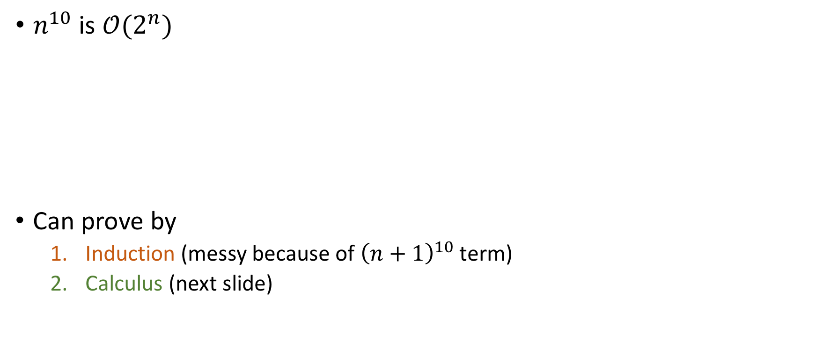
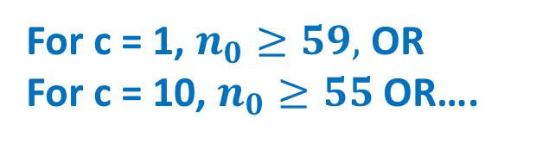
Polynomial vs Exponential
True and interesting
$$n$$ | $$n^{10}$$ | $$2^{n}$$
10 | $$\text{10}\text{,}\text{000}\text{,}\text{000}\text{,}\text{000}$$ | 1,024
20 | 10,240,000,000,000 | 1,048,576
30 | 590,490,000,000,000 | 1,073,741,824
40 | 10,485,760,000,000,000 | 1,099,511,627,776
$$⋮$$ | $$⋮$$ | $$⋮$$
$n^{10}$ is $𝒪(2^{n})$
Can prove by
Induction (messy because of ${\left(n+1\right)}^{10}$ term)
Calculus (next slide)
True but Stupid
False
For c = 1, $n_{0}≥59,$ OR
For c = 10, $n_{0}≥55$ OR….

Slide 25
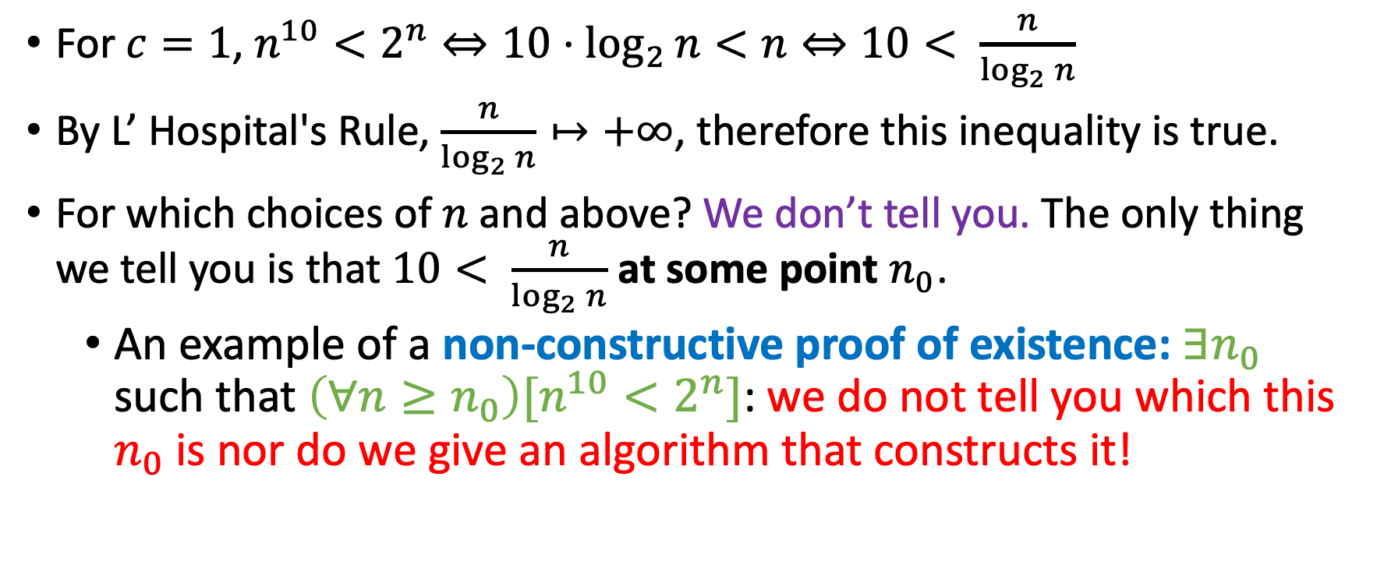

Proof by calculus that $n^{10}$ is $𝒪(2^{n})$
For $c=1$, $n^{10}<2^{n}⇔10⋅\log_{2}{n}<n⇔10< \frac{n}{\log_{2}{n}}$
By L’ Hospital's Rule, $\frac{n}{\log_{2}{n}}↦+∞$, therefore this inequality is true.
For which choices of $n$ and above? We don’t tell you. The only thing we tell you is that $10< \frac{n}{\log_{2}{n}}$ at some point $n_{0}$.
An example of a non-constructive proof of existence: $∃n_{0}$ such that $\left(∀n≥n_{0}\right)[n^{10}<2^{n}]$: we do not tell you which this $n_{0}$ is nor do we give an algorithm that constructs it!

Slide 26
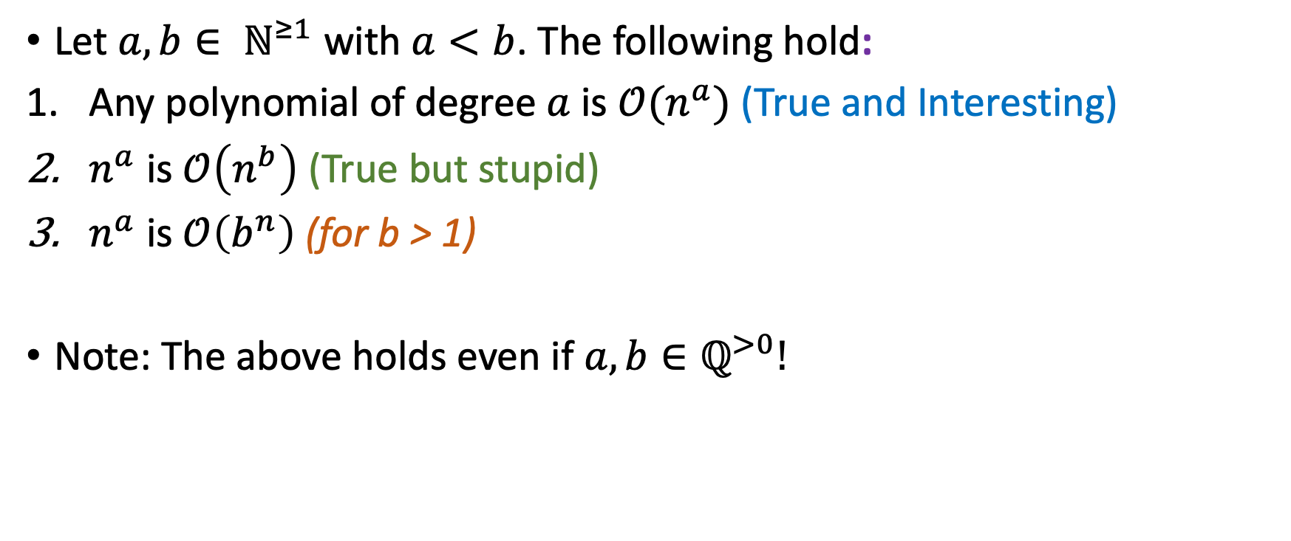
Polynomial Summary
Let $a, b∈ ℕ^{≥1}$ with $a<b$. The following hold:
Any polynomial of degree $a$ is $𝒪(n^{a})$ (True and Interesting)
$n^{a}$ is $𝒪\left(n^{b}\right)$ (True but stupid)
$n^{a}$ is $𝒪\left(b^{n}\right)$ (for b > 1)
Note: The above holds even if $a,b∈ℚ^{>0}!$

Slide 27
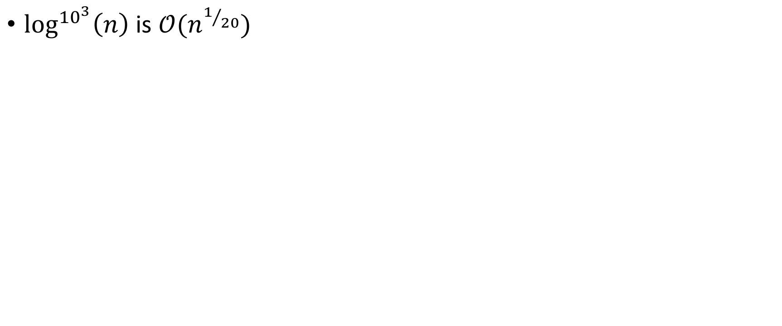
Logs
True and interesting
$\log^{{10}^{3}}\left(n\right)$ is $𝒪(n^{1/{20}})$
True but Stupid
False

Slide 28
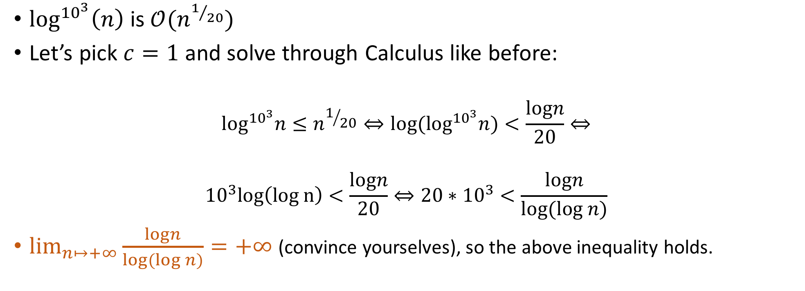
Logs
True and interesting
$\log^{{10}^{3}}\left(n\right) \text{is} 𝒪(n^{1/{20}})$
Let’s pick $c=1$ and solve through Calculus like before:
$$\log^{{10}^{3}}n≤n^{1/{20}}⇔{log⁡(log}^{{10}^{3}}n)<\frac{logn}{20}⇔$$
$${10}^{3}log\left(log n\right)<\frac{logn}{20}⇔20∗{10}^{3}<\frac{logn}{log(log n)}$$
$\lim_{n↦+∞}{\frac{logn}{log(log n)}}=+∞$ (convince yourselves), so the above inequality holds.
True but Stupid
False
Notes:
Tell the students that this is another non-constructive proof of existence.

Slide 29
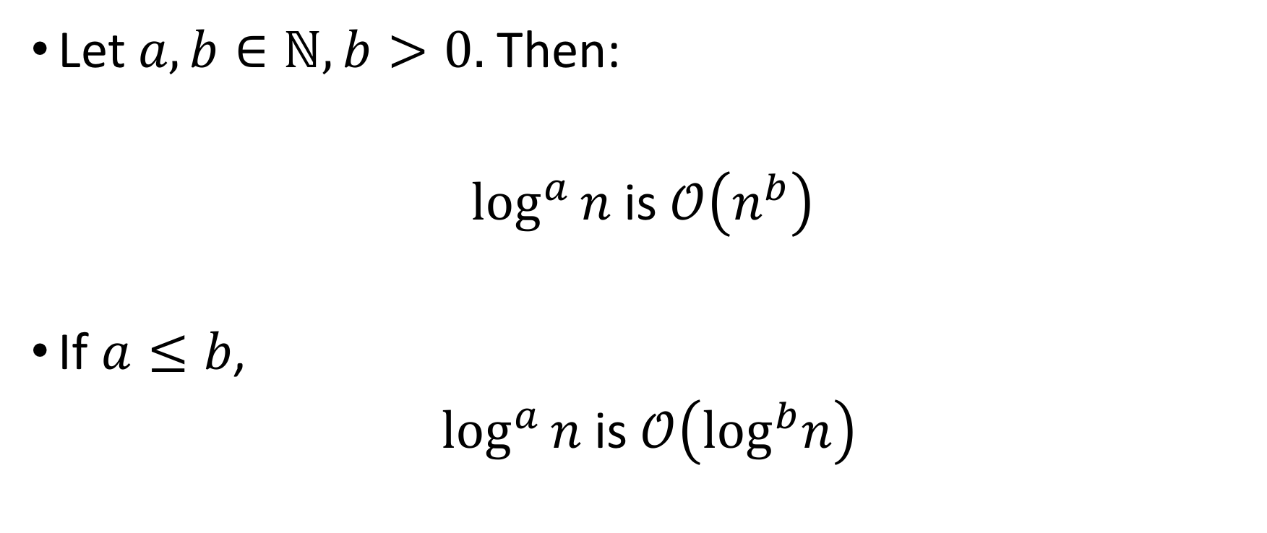
Log Summary
Let $a,b∈ℕ, b>0.$ Then:
$\log^{a}{n}$ is $𝒪\left(n^{b}\right)$
If $a≤b$,
$\log^{a}{n}$ is $𝒪\left(\log^{b}n\right)$

Slide 30
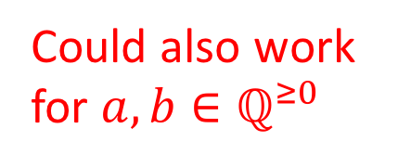
Log Summary
Let $a,b∈ℕ, b>0.$ Then:
$\log^{a}{n}$ is $𝒪\left(n^{b}\right)$
If $a≤b$,
$\log^{a}{n}$ is $𝒪\left(\log^{b}n\right)$
Could also work for $a,b∈ℚ^{≥0}$

Slide 31
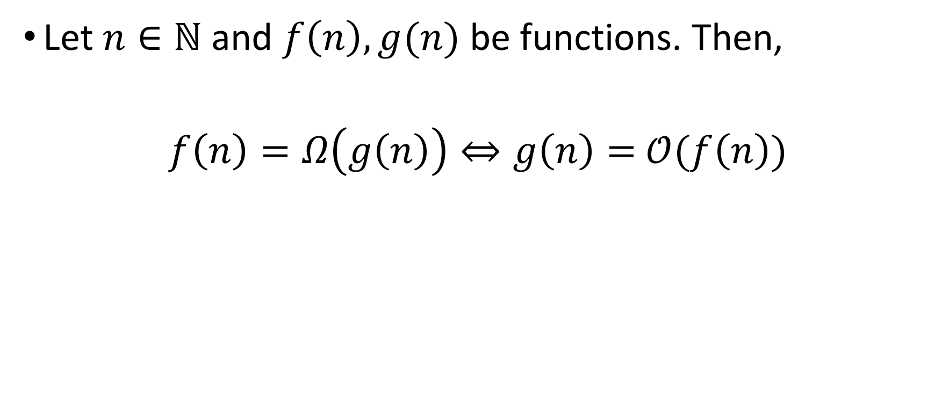

“Big-Omega” notation $(Ω\left(⋅\right))$
Let $n∈ℕ$ and $f\left(n\right), g(n)$ be functions. Then,
$f\left(n\right)=Ω\left(g\left(n\right)\right)⇔g\left(n\right)=$ $𝒪(f\left(n\right))$

Slide 32
“Big-Omega” notation $(Ω\left(⋅\right))$
LaTeX: \mathcal{\Omega}
Let $n∈ℕ$ and $f\left(n\right), g(n)$ be functions. Then,
$f\left(n\right)=Ω\left(g\left(n\right)\right)⇔g\left(n\right)=$ $𝒪(f\left(n\right))$

Slide 33
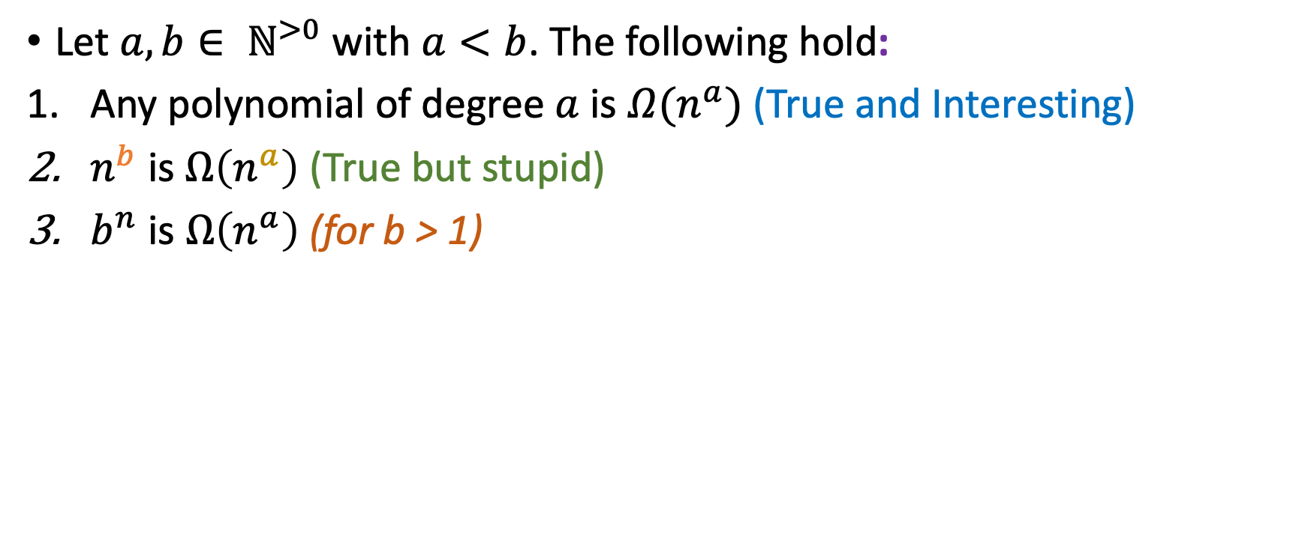
Polynomial Summary (Ω)
Let $a, b∈ ℕ^{>0}$ with $a<b$. The following hold:
Any polynomial of degree $a$ is $Ω(n^{a})$ (True and Interesting)
$n^{b}$ is $Ω\left(n^{a}\right)$ (True but stupid)
$b^{n}$ is $Ω\left(n^{a}\right)$ (for b > 1)

Slide 34
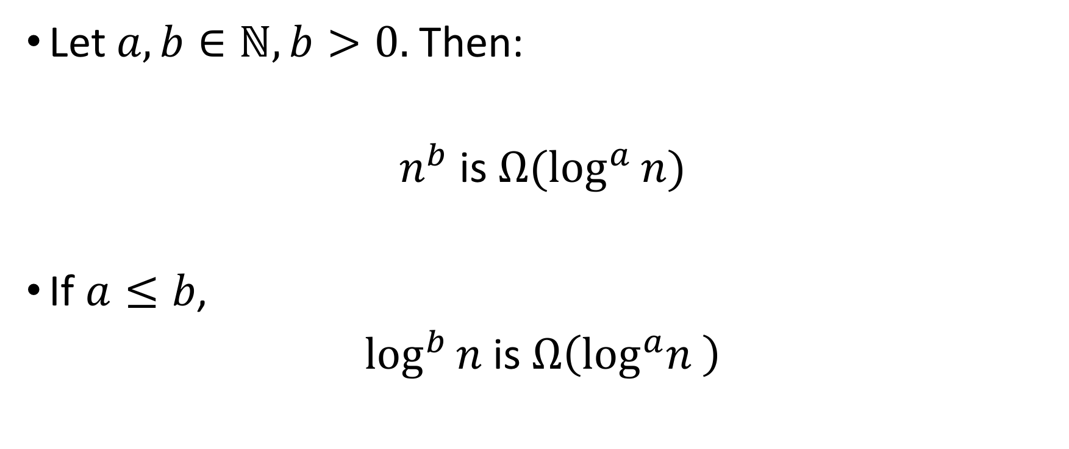
Log Summary (Ω)
Let $a,b∈ℕ, b>0.$ Then:
$n^{b}$ is $Ω(\log^{a}{n})$
If $a≤b$,
$\log^{b}{n}$ is $Ω\left({\log^{a}n}^{ }\right)$

Slide 35
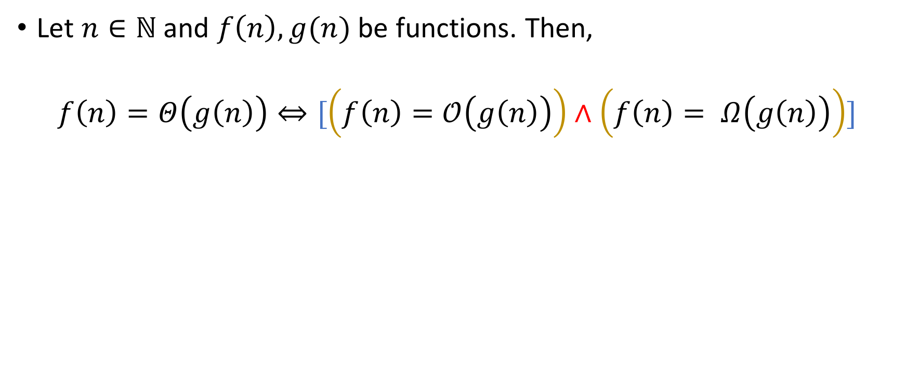

“Big Theta” notation ($Θ(⋅)$)
Let $n∈ℕ$ and $f\left(n\right), g(n)$ be functions. Then,
$$f\left(n\right)=Θ\left(g\left(n\right)\right)⇔[\left(f\left(n\right)=𝒪\left(g\left(n\right)\right)\right)∧\left(f\left(n\right)= Ω\left(g\left(n\right)\right)\right)]$$

Slide 36
“Big Theta” notation ($Θ(⋅)$)
LaTeX: \mathcal{\Theta}
Let $n∈ℕ$ and $f\left(n\right), g(n)$ be functions. Then,
$$f\left(n\right)=Θ\left(g\left(n\right)\right)⇔[\left(f\left(n\right)=𝒪\left(g\left(n\right)\right)\right)∧\left(f\left(n\right)= Ω\left(g\left(n\right)\right)\right)]$$

Slide 37
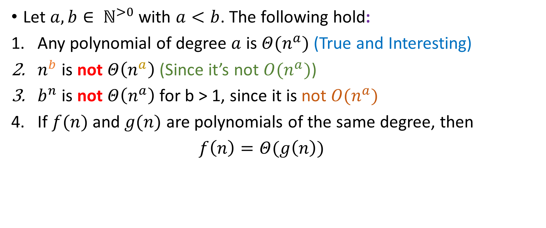
Polynomial Summary (Θ)
Let $a, b∈ ℕ^{>0}$ with $a<b$. The following hold:
Any polynomial of degree $a$ is $Θ(n^{a})$ (True and Interesting)
$n^{b}$ is not $Θ\left(n^{a}\right)$ (Since it’s not $O(n^{a})$)
$b^{n}$ is not $Θ\left(n^{a}\right)$for b > 1, since it is not $O(n^{a})$
If $f(n)$ and $g(n)$ are polynomials of the same degree, then
$f\left(n\right)=Θ(g\left(n\right))$

Slide 38
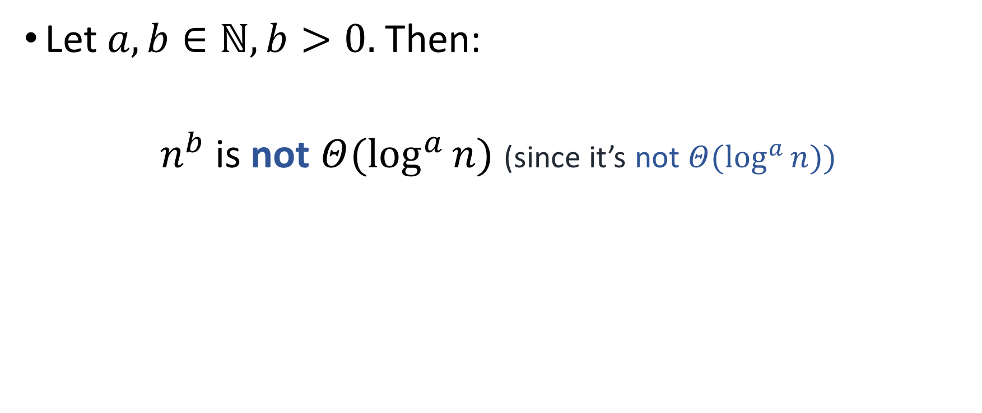
Log Summary (Θ)
Let $a,b∈ℕ, b>0.$ Then:
$n^{b}$ is not $Θ(\log^{a}{n})$ (since it’s not $Θ(\log^{a}{n}))$

Slide 39
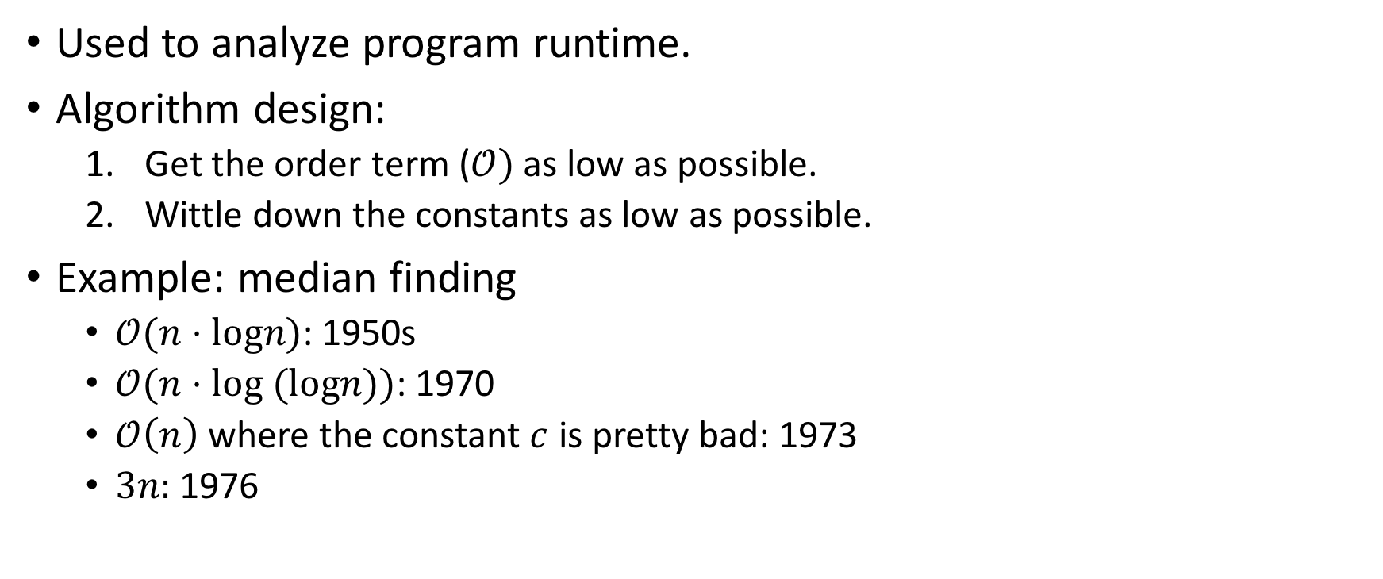
Applications
Used to analyze program runtime.
Algorithm design:
Get the order term ($𝒪)$ as low as possible.
Wittle down the constants as low as possible.
Example: median finding
$𝒪(n⋅logn)$: 1950s
$𝒪(n⋅log (logn))$: 1970
$𝒪\left(n\right)$ where the constant $c$ is pretty bad: 1973
$3n:$ 1976

Slide 40
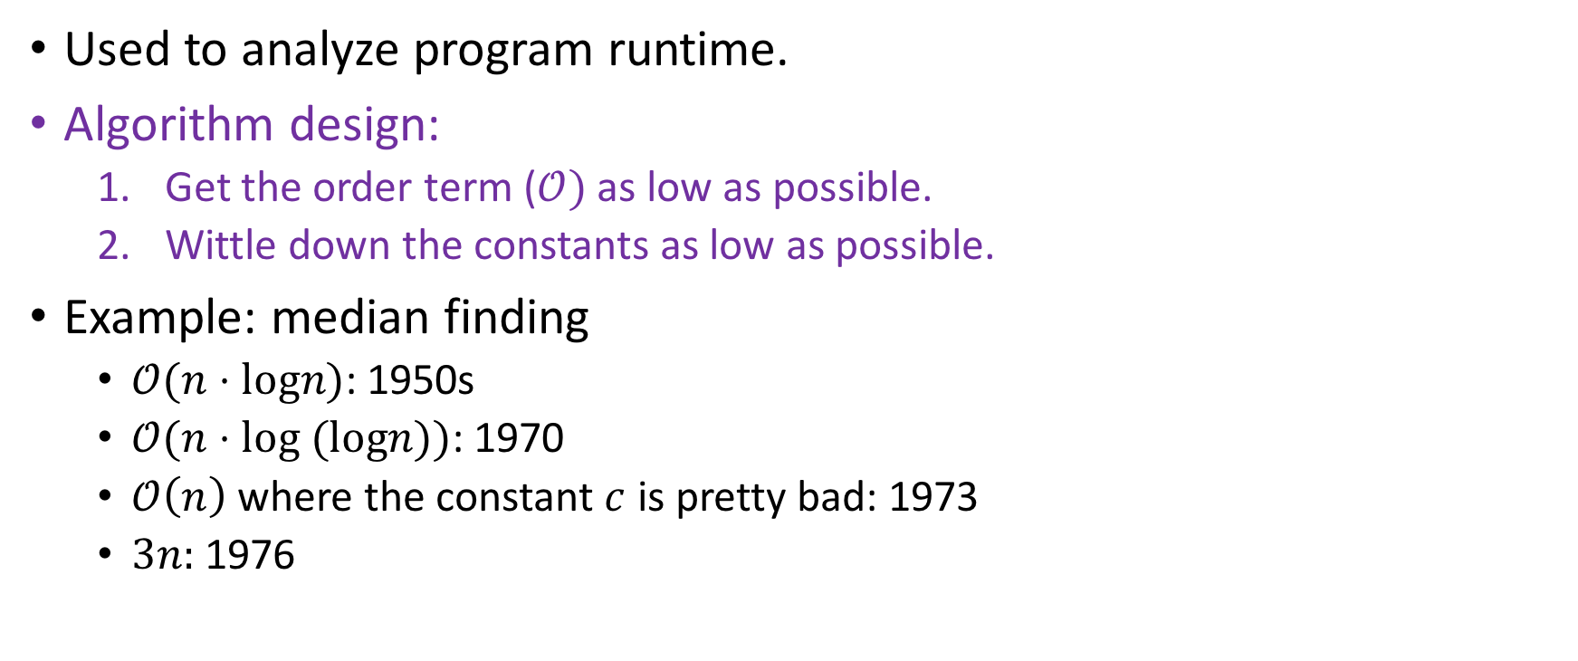
Applications
Used to analyze program runtime.
Algorithm design:
Get the order term ($𝒪)$ as low as possible.
Wittle down the constants as low as possible.
Example: median finding
$𝒪(n⋅logn)$: 1950s
$𝒪(n⋅log (logn))$: 1970
$𝒪\left(n\right)$ where the constant $c$ is pretty bad: 1973
$3n:$ 1976
We will do this right now! ☺

Slide 41
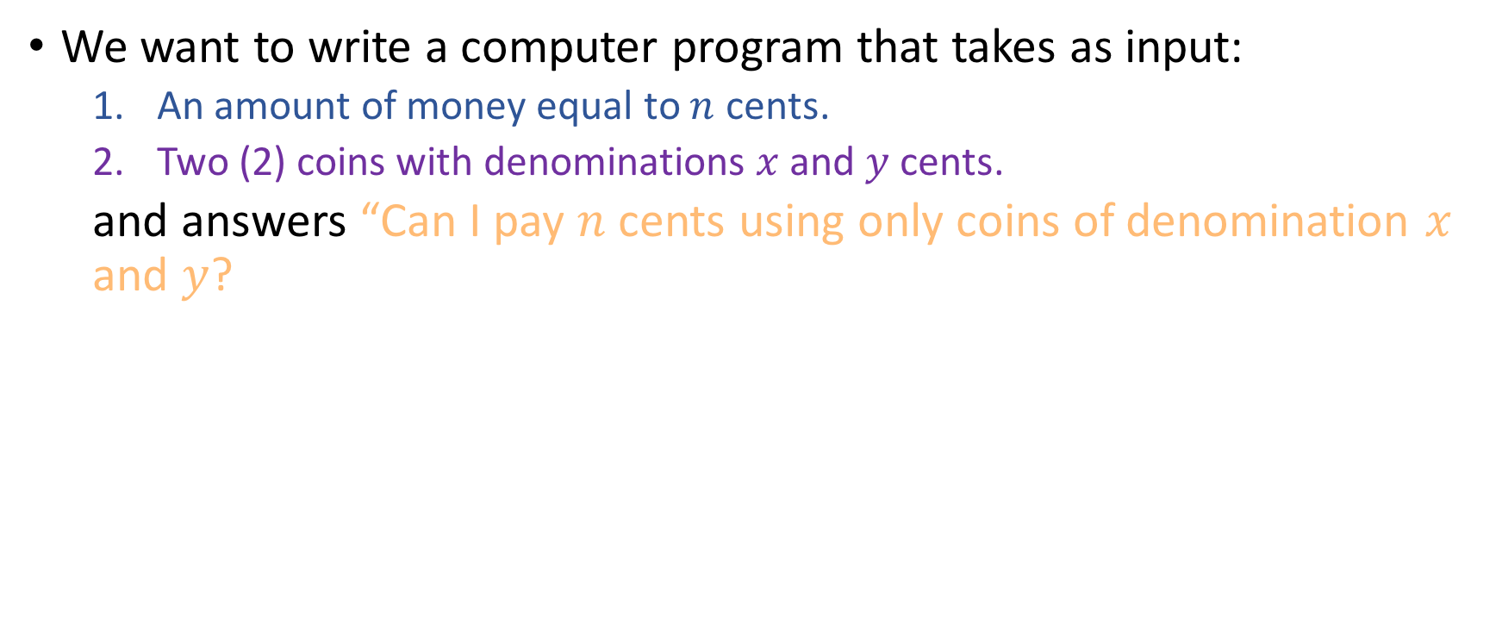
Algorithms for coins
We want to write a computer program that takes as input:
An amount of money equal to $n$ cents.
Two (2) coins with denominations $x$and $y$ cents.
and answers “Can I pay $n$ cents using only coins of denomination $x$ and $y$?

Slide 42
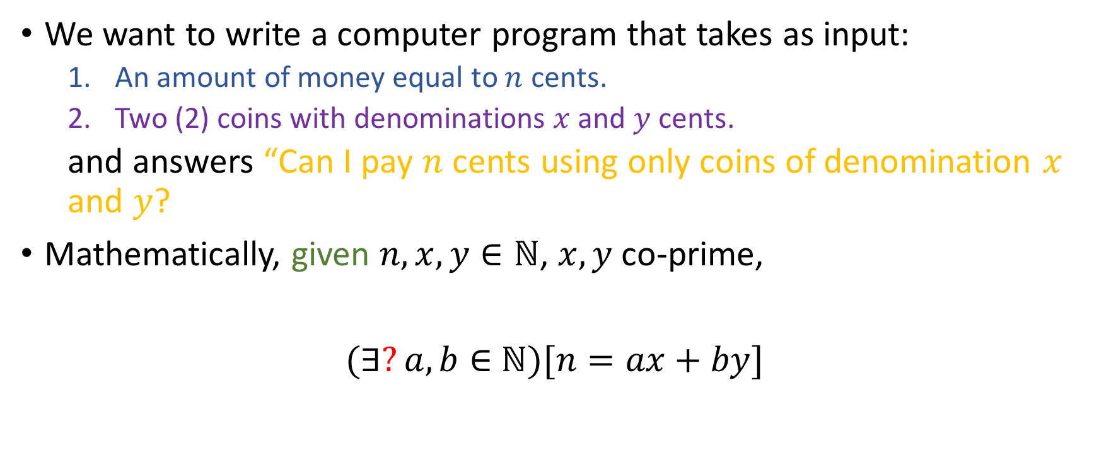
Algorithms for coins
We want to write a computer program that takes as input:
An amount of money equal to $n$ cents.
Two (2) coins with denominations $x$and $y$ cents.
and answers “Can I pay $n$ cents using only coins of denomination $x$ and $y$?
Mathematically, given $n,x,y∈ℕ$, $x,y$ co-prime,
$(∃?a,b∈$ $ℕ)[n=ax+by]$

Slide 43
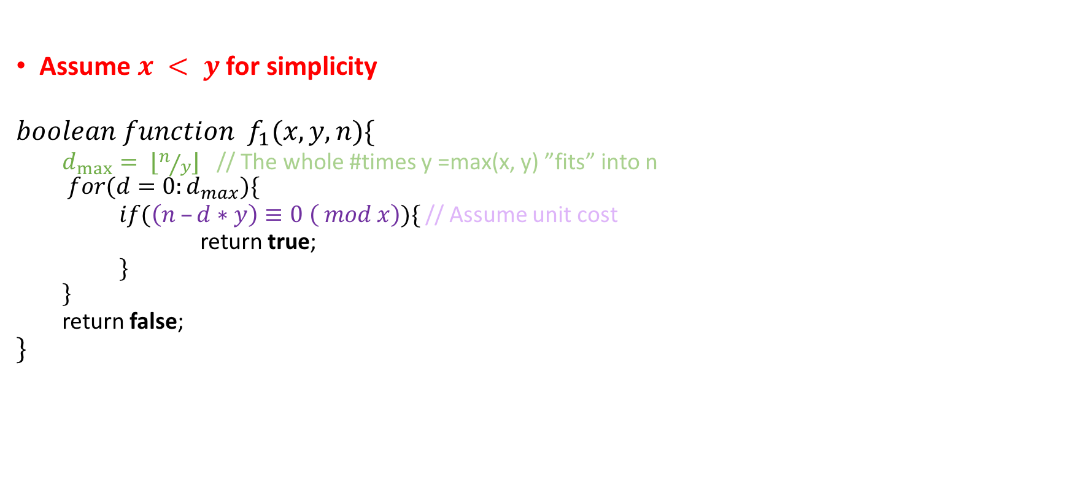
First algorithm
Assume $x < y$ for simplicity
$$boolean function f_{1}(x, y, n)\{$$
$d_{max}⁡= ⌊n/y⌋$ // The whole #times y =max(x, y) ”fits” into n
$$for(d=0:d_{max})\{$$
$if(\left(n –d∗y\right)≡0 \left( mod x\right))\{$ // Assume unit cost
return true;
$\}$
$$\}$$
return false;
$$\}$$

Slide 44
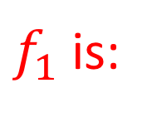
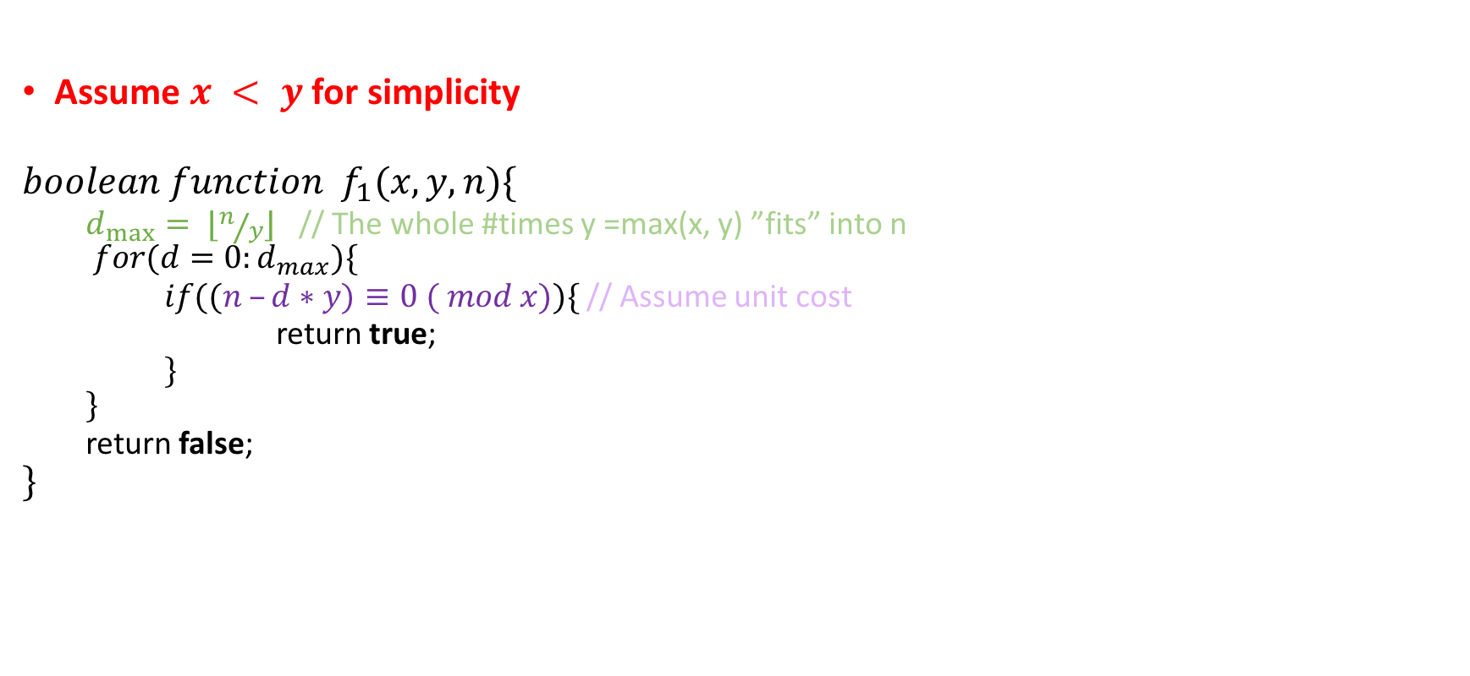
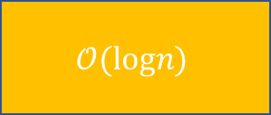


First algorithm
Assume $x < y$ for simplicity
$$boolean function f_{1}(x, y, n)\{$$
$d_{max}⁡= ⌊n/y⌋$ // The whole #times y =max(x, y) ”fits” into n
$$for(d=0:d_{max})\{$$
$if((n –d∗y)≡0 ( mod x))\{$ // Assume unit cost
return true;
$\}$
$$\}$$
return false;
$$\}$$
$f_{1}$ is:
$$𝒪(n)$$
$$𝒪(n^{2})$$
$$𝒪(logn)$$
Something Else

Slide 45
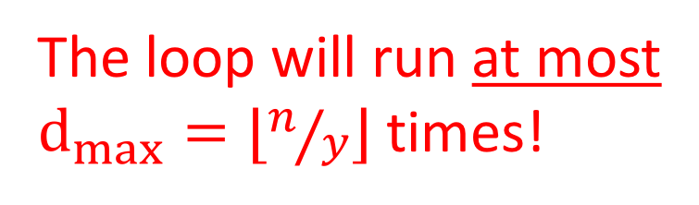
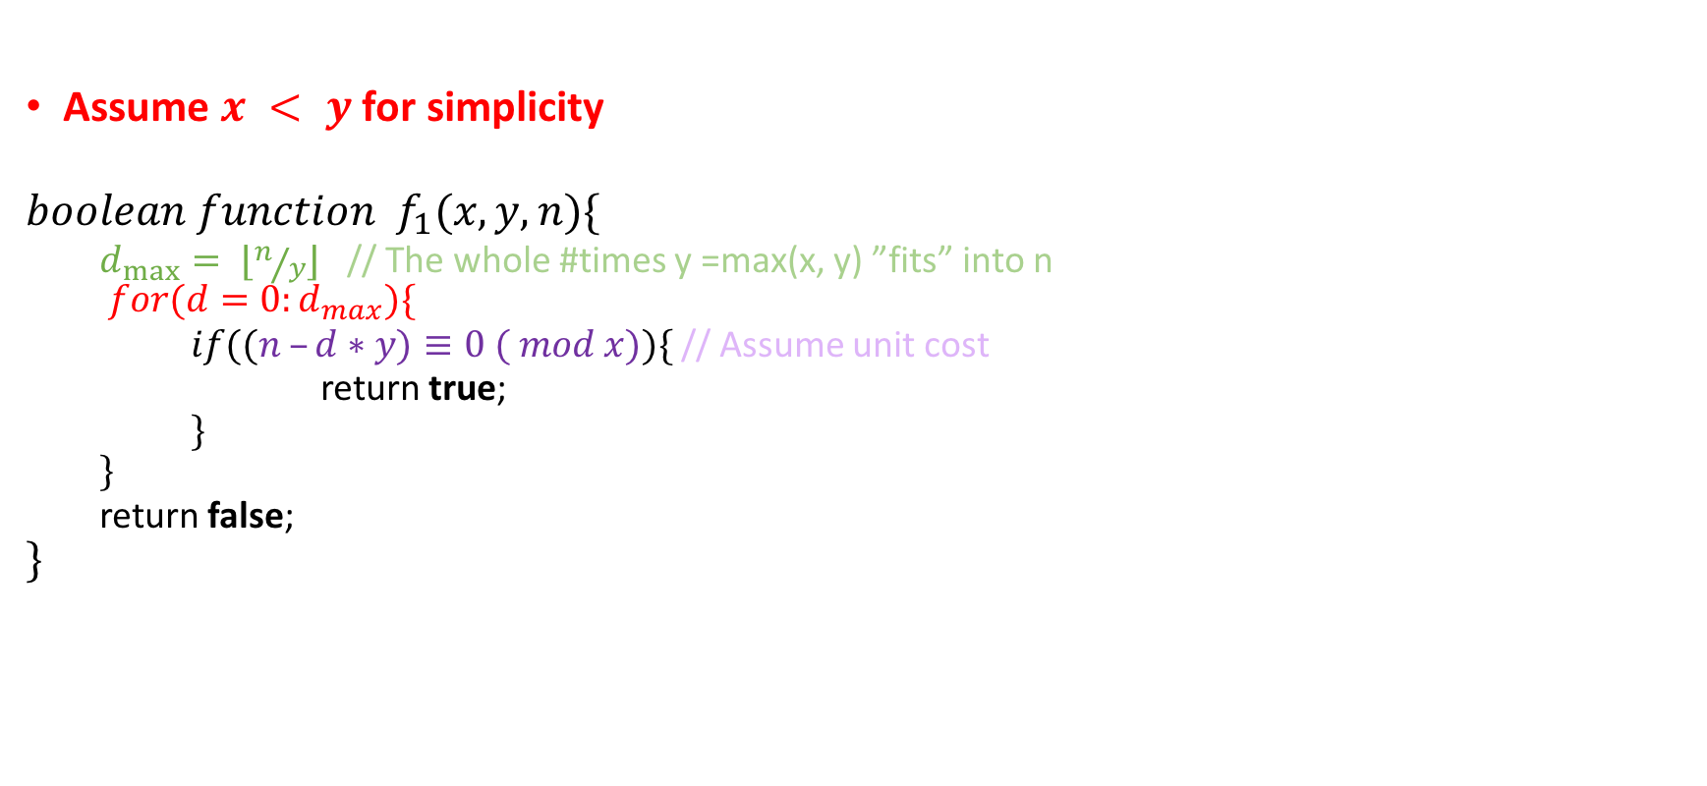
First algorithm
Assume $x < y$ for simplicity
$$boolean function f_{1}(x, y, n)\{$$
$d_{max}⁡= ⌊n/y⌋$ // The whole #times y =max(x, y) ”fits” into n
$$for(d=0:d_{max})\{$$
$if((n –d∗y)≡0 ( mod x))\{$ // Assume unit cost
return true;
$\}$
$$\}$$
return false;
$$\}$$
The loop will run at most $d_{max}=⌊n/y⌋$ times!
$f_{1}$ is:
$$𝒪(n)$$
$$𝒪(n^{2})$$
$$𝒪(logn)$$
Something Else

Slide 46
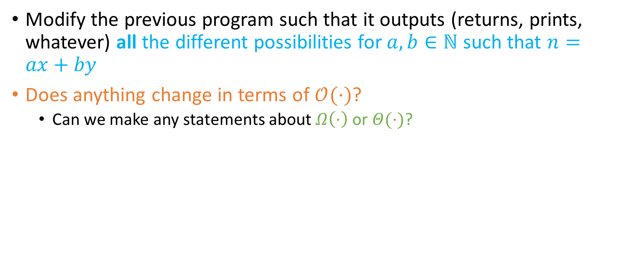
(Ungraded) homework for you!
Modify the previous program such that it outputs (returns, prints, whatever) all the different possibilities for $a,b∈ℕ$ such that $n=ax+by$
Does anything change in terms of $𝒪(⋅)$?
Can we make any statements about $Ω\left(⋅\right)$ or $Θ(⋅)$?

Slide 47
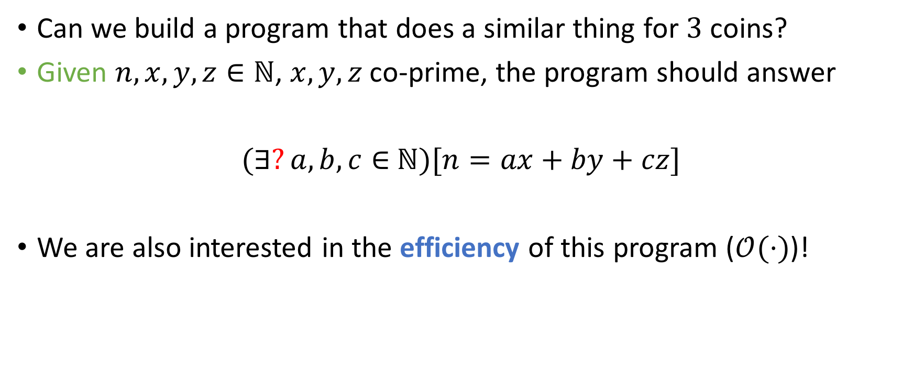
Generalization
Can we build a program that does a similar thing for $3$ coins?
Given $n,x,y,z∈ℕ$, $x,y,z$ co-prime, the program should answer
$(∃?a,b,c∈$ $ℕ)[n=ax+by+cz]$
We are also interested in the efficiency of this program ($𝒪(⋅)$)!

Slide 48


Generalization
Can we build a program that does a similar thing for $3$ coins?
Given $n,x,y,z∈ℕ$, $x,y,z$ co-prime, the program should answer
$(∃?a,b,c∈$ $ℕ)[n=ax+by+cz]$
We are also interested in the efficiency of this program ($𝒪(⋅)$)!

Slide 49
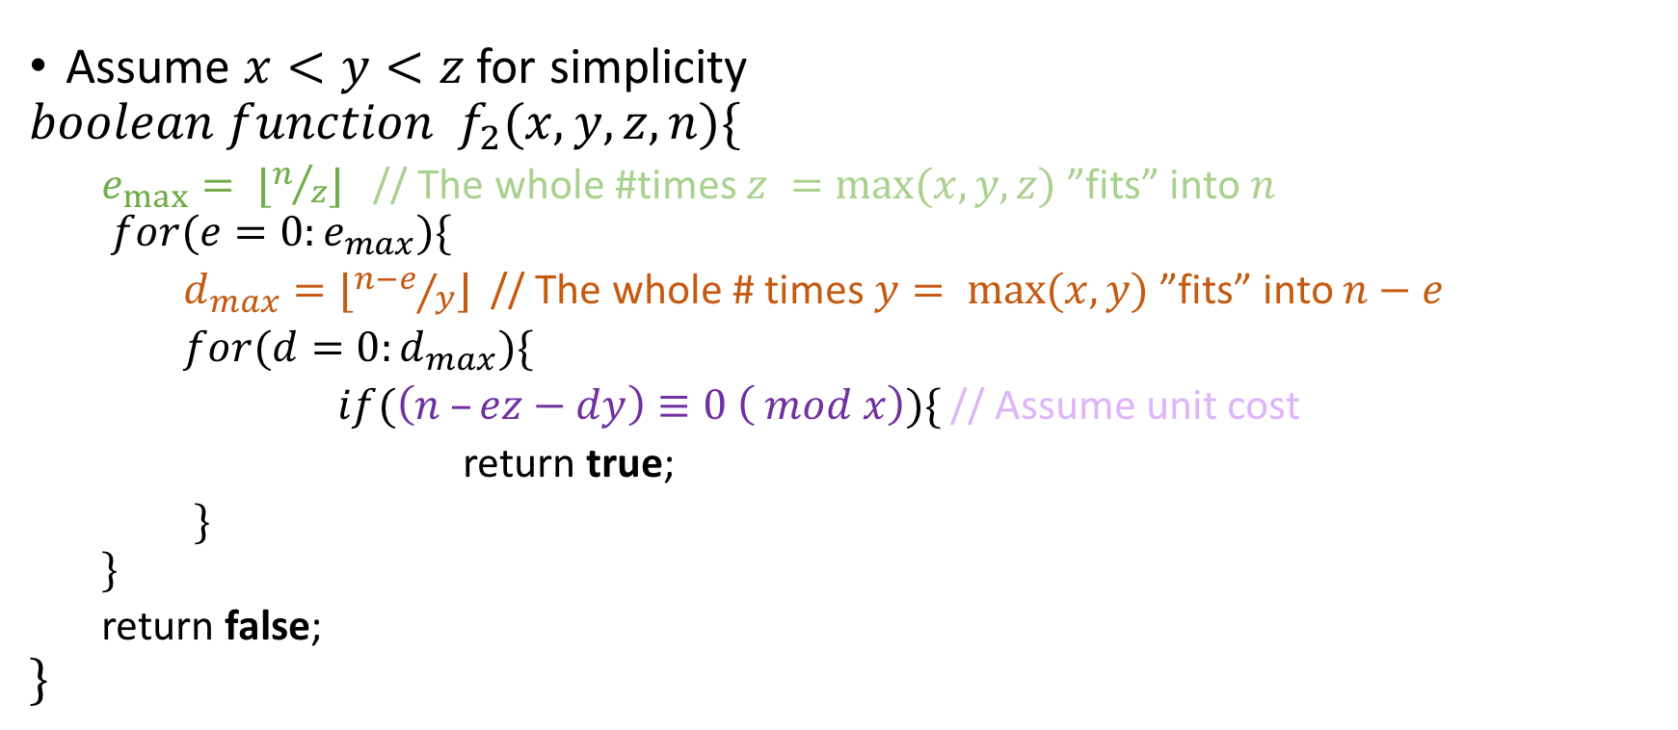
Second algorithm
Assume $x<y<z$ for simplicity
$$boolean function f_{2}(x, y, z, n)\{$$
$e_{max}⁡= ⌊n/z⌋$ // The whole #times $z =max⁡(x, y, z)$ ”fits” into $n$
$$for(e=0:e_{max})\{$$ $d_{max}=⌊{n−e}/y⌋$ // The whole # times $y= max⁡(x, y)$”fits” into $n−e$
$for(d=0:d_{max})\{$
$if(\left(n –ez−dy\right)≡0 \left( mod x\right))\{$ // Assume unit cost
return true;
$\}$
$$\}$$
return false;
$$\}$$

Slide 50
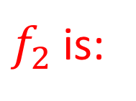
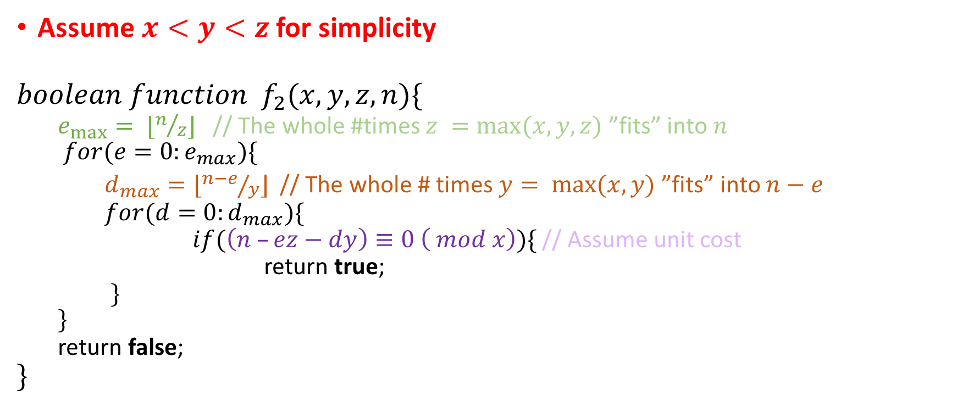
Second algorithm-runtime
Assume $x<y<z$ for simplicity
$$boolean function f_{2}(x, y, z, n)\{$$
$e_{max}⁡= ⌊n/z⌋$ // The whole #times $z =max⁡(x, y, z)$ ”fits” into $n$
$$for(e=0:e_{max})\{$$ $d_{max}=⌊{n−e}/y⌋$ // The whole # times $y= max⁡(x, y)$”fits” into $n−e$
$for(d=0:d_{max})\{$
$if(\left(n –ez−dy\right)≡0 \left( mod x\right))\{$ // Assume unit cost
return true;
$\}$
$$\}$$
return false;
$$\}$$
$f_{2}$ is:
$$𝒪(n)$$
$$𝒪(n^{2})$$
$$𝒪(logn)$$
Something Else

Slide 51


Second algorithm-runtime
Both loops will run at most ${n^{2}}/{zy}$ times!
Assume $x<y<z$ for simplicity
$$boolean function f_{2}(x, y, z, n)\{$$
$e_{max}⁡= ⌊n/z⌋$ // The whole #times $z =max⁡(x, y, z)$ ”fits” into $n$
$$for(e=0:e_{max})\{$$ $d_{max}=⌊{n−e}/y⌋$ // The whole # times $y= max⁡(x, y)$”fits” into $n−e$
$for(d=0:d_{max})\{$
$if(\left(n –ez−dy\right)≡0 \left( mod x\right))\{$ // Assume unit cost
return true;
$\}$
$$\}$$
return false;
$$\}$$
$f_{2}$ is:
$$𝒪(n)$$
$$𝒪(n^{2})$$
$$𝒪(logn)$$
Something Else

Slide 52

(Ungraded) homework for you
Modify algorithm to produce the NUMBER of ways $n$ can be written as a sum of $x$'s and $y$'s.
Modify to produce HOW $n$ can be written as $x$'s and $y$'s.

Slide 53

Second algorithm-runtime
$f_{2}$ is $𝒪(n^{2})$
constant = $\frac{1}{zy}$
Good if $z, y$ large
Intuition: for large $z, y, e_{max}=\left\lfloor n/z\right\rfloor$ and $d_{max}=⌊{(n−e)}/y⌋$ are small, so the loops don’t run for many steps!
Bad if $z, y$ small ☹

Slide 54
Second algorithm-runtime
$f_{2}$ is $𝒪(n^{2})$
constant = $\frac{1}{zy}$
Good if $z, y$ large
Intuition: for large $z, y, e_{max}=\left\lfloor n/z\right\rfloor$ and $d_{max}=⌊{(n−e)}/y⌋$ are small, so the loops don’t run for many steps!
Bad if $z, y$ small ☹
CAN WE DO BETTER?

Slide 55

Second algorithm-runtime
$f_{2}$ is $𝒪(n^{2})$
constant = $\frac{1}{zy}$
Good if $z, y$ large
Intuition: for large $z, y, e_{max}=\left\lfloor n/z\right\rfloor$ and $d_{max}=⌊{(n−e)}/y⌋$ are small, so the loops don’t run for many steps!
Bad if $z, y$ small ☹
CAN WE DO BETTER?

Slide 56

Third algorithm
We will present another algorithm for the three coin problem, which runs in $𝒪(n)$
It uses memoization/dynamic programming.
Interesting point: In CS, often easier to solve a harder problem that the problem at hand.
In this case, we can efficiently find all $i$ between $0$ and $n$ such that $i$ can be written as $a_{i}x+b_{i}y+c_{i}z$ for $a_{i},b_{i},c_{i}∈ℕ$!

Slide 57

Third algorithm – Take 1
Assume $x<y<z$ for simplicity
$$A[0]=true$$
$$for (i=1 to n)\{$$
$$if A[i−x]=true or A[i−y]=true or A[i−z]=true$$
$A[i]=true$
$else$
$A[i]=false$
$$\}$$

Slide 58

Third algorithm – Take 1
Assume $x<y<z$ for simplicity
$$A[0]=true$$
$$for (i=1 to n)\{$$
$$if A[i−x]=true or A[i−y]=true or A[i−z]=true$$
$A[i]=true$
$else$
$A[i]=false$
$$\}$$
This is susceptible to out of bounds errors immediately…☹
So we need to improve it.

Slide 59

Third algorithm – Take 2
If $i −x<0$ or $i −y<0$ or $i−z<0$, we should have $A\left[i−x\right]=false$ or $A\left[i−y\right]=false$ or $A\left[i−z\right]=false$
Since we assume that $x<y<z,$ we have that the smallest possible value we can reach for any $i$ is $i−z$.

Slide 60

Third algorithm – Take 2
$for (i=−z to −1)${
$A[i]=false$
}
$$A[0]=true$$
$$for (i=1 to n)\{$$
$$If A\left[i−x\right]=true or A\left[i−y\right]=true or A[i−z]=true$$
$A[i]=true$
$else$
$A[i]=false$
$$\}$$

Slide 61

Third algorithm – Take 2
$for (i=−z to −1)${
$A[i]=false$
}
$$A[0]=true$$
$$for (i=1 to n)\{$$
$$If A\left[i−x\right]=true or A\left[i−y\right]=true or A[i−z]=true$$
$A[i]=true$
$else$
$A[i]=false$
$$\}$$
Unfortunately, we cannot really index into negative positions of an array…. ☹

Slide 62


Third algorithm – Take 3
$for (i=0 to z−1)${
$A[i]=false$
}
$$A[z]=true$$
$$for (i=z+1 to n+z)\{$$
$$If A\left[i−x\right]=true or A\left[i−y\right]=true or A[i−z]=true$$
$A[i]=true$
$else$
$A[i]=false$
$$\}$$
But we can always shift everything by $z$! ☺

Slide 63


Third algorithm – Take 3
$for (i=0 to z−1)${
$A[i]=false$
}
$$A[z]=true$$
$$for (i=z+1 to n+z)\{$$
$$If A\left[i−x\right]=true or A\left[i−y\right]=true or A[i−z]=true$$
$A[i]=true$
$else$
$A[i]=false$
$$\}$$
But we can always shift everything by $z$! ☺
This makes our array from size $n$ to size $n + z$. Since $n≫z$, space is still $O(n)$!

Slide 64

Third algorithm – Take 3
$for (i=0 to z−1)${
$A[i]=false$
}
$$A[z]=true$$
$$for (i=z+1 to n+z)\{$$
$$If A\left[i−x\right]=true or A\left[i−y\right]=true or A[i−z]=true$$
$A[i]=true$
$else$
$A[i]=false$
$$\}$$
But we can always shift everything by $z$! ☺
This makes our array from size $n$ to size $n + z$. Since $n≫z$, space is still $O(n)$!
$n≫z$also explains why this loop is correct

Slide 65

Third algorithm – Take 3
$for (i=0 to z−1)${
$A[i]=false$
}
$$A[z]=true$$
$$for (i=z+1 to n+z)\{$$
$$If A\left[i−x\right]=true or A\left[i−y\right]=true or A[i−z]=true$$
$A[i]=true$
$else$
$A[i]=false$
$$\}$$
But we can always shift everything by $z$! ☺
F | F | F | F | T | F | ? | ?
0 | 1 | … | $$z−1$$ | $$z$$ | $$z+1$$ | … | $$n+z$$

Slide 66




Third algorithm – Take 3
$$𝒪(n)$$
$$𝒪(logn)$$
$for (i=0 to z−1)${
$A[i]=false$
}
$$A[z]=true$$
$$for (i=z+1 to n+z)\{$$
$$If A\left[i−x\right]=true or A\left[i−y\right]=true or A[i−z]=true$$
$A[i]=true$
$else$
$A[i]=false$
$$\}$$
Runtime =… ?
$$𝒪(n⋅logn)$$
Something Else

Slide 67


Third algorithm – Take 3
$$𝒪(n)$$
$$𝒪(logn)$$
$for (i=0 to z−1)${
$A[i]=false$
}
$$A[z]=true$$
$$for (i=z+1 to z+n)\{$$
$$If A\left[i−x\right]=true or A\left[i−y\right]=true or A[i−z]=true$$
$A[i]=true$
$else$
$A[i]=false$
$$\}$$
$$z +1+ n=𝒪(n)$$
assignments (since $n≫z)$!
$$𝒪(n⋅logn)$$
Something Else

